Slide 1
Presentation for CCRPC Executive Committee
By Hickok & Boardman HR Intelligence

Slide 2
HBHRIQ
Process
9

Slide 3
Our Process
Strategic Planning –Working Together to Meet Your Goals
Assessment
Planning
Implementation
Evaluation
Inventory Phase:
Information and data collection
Evaluate current programs and plans
Gain better insight of your organization and compensation/benefit philosophy
Comparative Analysis
Analyze results against Employee data
Identify gaps
Findings and Recommendations
Consider the Results:
Consult on addressing gaps and how to implement changes
Assessment Phase:
Review Job Descriptions and Classification Structures
Review Benefit and Pay Plans
Conduct Benchmarking
10

Slide 4
Our Process
Total Rewards Philosophy
Creating a high level of employee engagement is critical to the organization’s success
Today’s best employers engage employees through a mixture of total compensation and programs
Next-generation approach to total rewards is a fundamental shift in philosophy
Consider your workforce programs as a portfolio of integrated investments with different yet complementary purposes and desired outcomes
11

Slide 5
Our Process
Phase 1: Discovery
Determine objectives and scope of project
Discuss timetable
Establish communication channels/identify points of contact for various tasks
Discuss process for access to relevant data and data collection methodology
Collect and review data (Employee Handbook, Pay Ranges, Job Descriptions, Benefits Programs and Information)
12

Slide 6
Our Process
Phase 2: Assessment
Classification and Job Evaluation
Review current job classifications and pay structure(s), understanding changes over time and historical context
Review current job descriptions
Partner with Human Resources to gather background information, obtain and discuss benchmark classifications and other internal positions that might be impacted as a result of the study
Review job duties, responsibilities, and knowledge, skills and abilities needed for each job
Assess job evaluation system currently in use (current administrative and classification maintenance procedures and methods)
13

Slide 7
Our Process
Phase 2: Assessment
Compensation System
Review the compensation philosophy of the organization, how it relates to compensation management practices, and identify 1) labor markets for comparison, 2) classification structure, and 3) relationship between performance evaluation and pay
Review the compensation management policies and practices
Benchmark total compensation program against its current competitive market and other potential competitor jurisdictions
14

Slide 8
Our Process
Phase 3: Comparative Analysis
Utilize suite of compensation tools including a proprietary database with compensation market ranges for more than 8,000 benchmark jobs, to efficiently analyze data for relevant jobs and pay markets
Compare employee pay and market data
Review CCRPC benefits programs, and current pay practices to make recommendations on compensation strategies for consideration
Identify gaps and opportunities for improvement
15

Slide 9
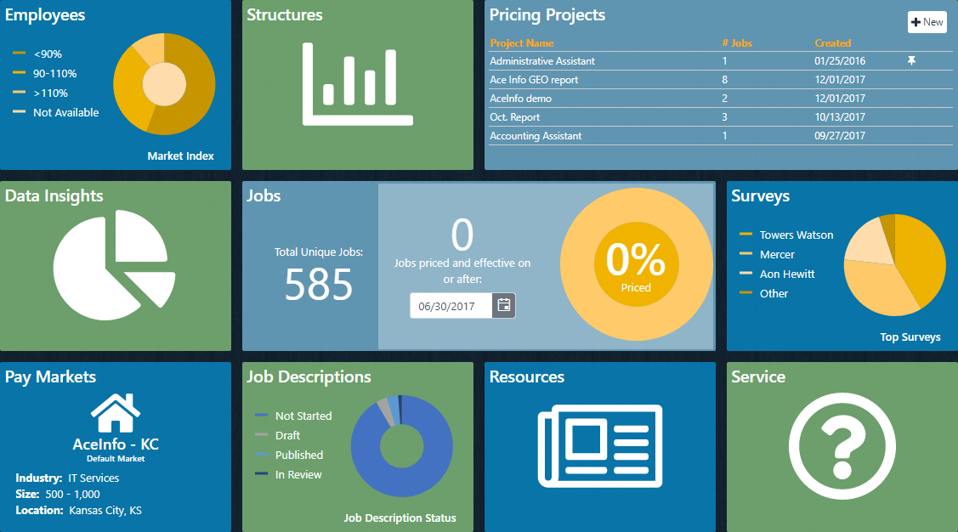
We use a fully integrated compensation data management suite
Payfactors System
Compensation data unification and analysis is stored in the cloud
Project-based to allow for easy updates in the future
17

Slide 10
Pay Markets
11 custom built Pay Markets, designed specifically for CCRPC
Markets were selected based on competition for talent
Streamlined approach to multi-market analysis
The following titles and corresponding data, was researched using Bureau of Labor Statistics (BLS) salary survey data from the May 2018 Metropolitan and Nonmetropolitan Area Occupational Employment and Wage Estimates, for the Northern Vermont nonmetropolitan area:
Title | Occupation Code | Employment per 1,000 jobs | Median hourly wage | Mean hourly wage | Annual mean wage
Civil Engineers | 17-2051 | 3.512 | $35.52 | $36.98 | $76,920
Urban and Regional Planners | 19-3051 | 0.583 | $29.71 | $31.40 | $65,320
22

Slide 11
CCRPC Pay Markets
Industry | Organization Size | Region
Not-for-Profit, Association/Government | 50-100 Employees | Burlington, VT
Not-for-Profit, Association/Government | 100-200 Employees | Burlington, VT
Not-for-Profit, Association/Government | 50-100 Employees | Bristol, CT
Not-for-Profit, Association/Government | 50-100 Employees | Portland, ME
Not-for-Profit, Association/Government | 50-100 Employees | Portsmouth, NH
Not-for-Profit, Association/Government | 50-100 Employees | Taunton, MA
Not-for-Profit, Association/Government | 50-100 Employees | Salem, OR
Not-for-Profit, Association/Government | 50-100 Employees | Northeastern U.S.
Not-for-Profit, Association/Government | 3,000-7,500 Employees | Vermont
Engineering | 100-200 Employees | Vermont
Engineering | 100-200 Employees | Northeastern U.S.
22

Slide 12
Benefits Overview
Standard | Paid Leave | Other
Medical | Combined PTO | Wellness
Dental | Holiday | Education/Tuition
Life | Bereavement | Flexible schedules/telework
LTD/STD | Court | Commuting
Retirement | Blood donation | Pets at work
 | Volunteer

Slide 13
2019 Medical Plan Details
Large Employers – High Deductible Plans | Vermont Average | CCRPC
Deductible (Single/Family) | $2,825/ $5,525 | $2,700 / $5,400
Out-of-Pocket Maximum (Single/Family) | $3,017/ $6,116 | $2,700 / $5,400
Monthly Premium Rate Single Two Person Family | $602 $1,146 $1,671 | $584 $1,168 $1,640
Monthly Employee Contributions Single Two Person Family | $95 $292 $447 | $88 $175 $246
Coinsurance Amounts | 75% | 100%
HSA Funding Single Two Person Family | $1,295 $2,413 $2,423 | $2,700 $5,400 $5,400

Slide 14
2019 Dental Plan Details
All Employers – Dental Plans | Vermont Average | CCRPC
Deductible (Single / Family) | $111 / $304 | $100 / $300
Class A Coverage (Preventive) | 99% | 100%
Class B Coverage (Basic) | 75% | 80%
Class C Coverage (Major) | 51% | 50%
Class D Coverage (Orthodontics) | 54% | 50%
Plan Year Maximum (Class A, B, C) | $1,621 | $2,000
Lifetime Maximum for Orthodontic Coverage | $1,522 | $1,500
Monthly Premium Rate Single Two Person Family | $41 $77 $127 | $50 $92 $162
Monthly Employee Contributions Single Two Person Family | $15 $36 $64 | $0 $0 $0

Slide 15
Our Process
Phase 4: Findings and Recommendations
Highlight best practices
Provide summary recommendations
Identify pay management issues (equity, high/low to market)
Identify any possible barriers to implementation
30

Slide 16
CCRPC Findings and Recommendations
Adjust pay ranges consistent with the market analysis provided; see additional position specific analysis (next slide)
Formally define and communicate CCRPC compensation philosophy throughout the organization
Develop a communication plan and strategies to showcase CCRPC’s total rewards programs
Consider a performance-based bonus structure based on individual and organization performance targets and achievement (does not build to base salary)
Consider a discretionary bonus program to recognize and reward behaviors consistent with organization values, project-based work, innovation and creativity
Conduct an employee engagement survey to determine which voluntary benefit offerings will most resonate with your employees and craft a strategy for delivery
Begin to develop career path models and progression for newer, less senior employees, as appropriate
30

Slide 17
CCRPC Position Specific Analysis/Recommendations
Title | Wage Range | Incumbent Rate of Pay
Executive Director | Shift to the right | Low to market
Program Director | Consider Program Director III data and shift wage ranges to the right | Low to market
GIS Data & IT Manager | Shift to the right | Bumping up against current max due to experience.
Senior Planner | Slight shift to the right to bring up the min | Newly promoted SP may fall out of range. Develop a plan based on training/competency to get the individual back into range.
Senior Transportation Planner | Slight shift to the right to bring up the min | 2/3 bumping up against current max due to experience.
Senior Transportation Planning Engineer | Slight shift to the right to bring up the min
Transportation Planning Engineer | Shift to the right | Bumping up against current max due to experience.
Transportation Planner | Slight shift to the right to bring up the min
Planner | Slight shift to the right to bring up the min
Assistant Planner | Slight shift to the right to bring up the min
Communications Manager | No adjustment necessary
Senior Business Manager | Shift to the right | Low to market
Business Office Associate II | No adjustment needed | Well penetrated in range – presumably due to experience
30

Slide 18
Meet our Team of Experts
Vision: To help create the leading workplaces of tomorrow.
Since 1821
Innovative culture
Boutique HR services firm
Benefits
Compensation & Classification
Compliance
Cost Containment
HR Technology
Training & Development
Wellness
2

