Slide 1
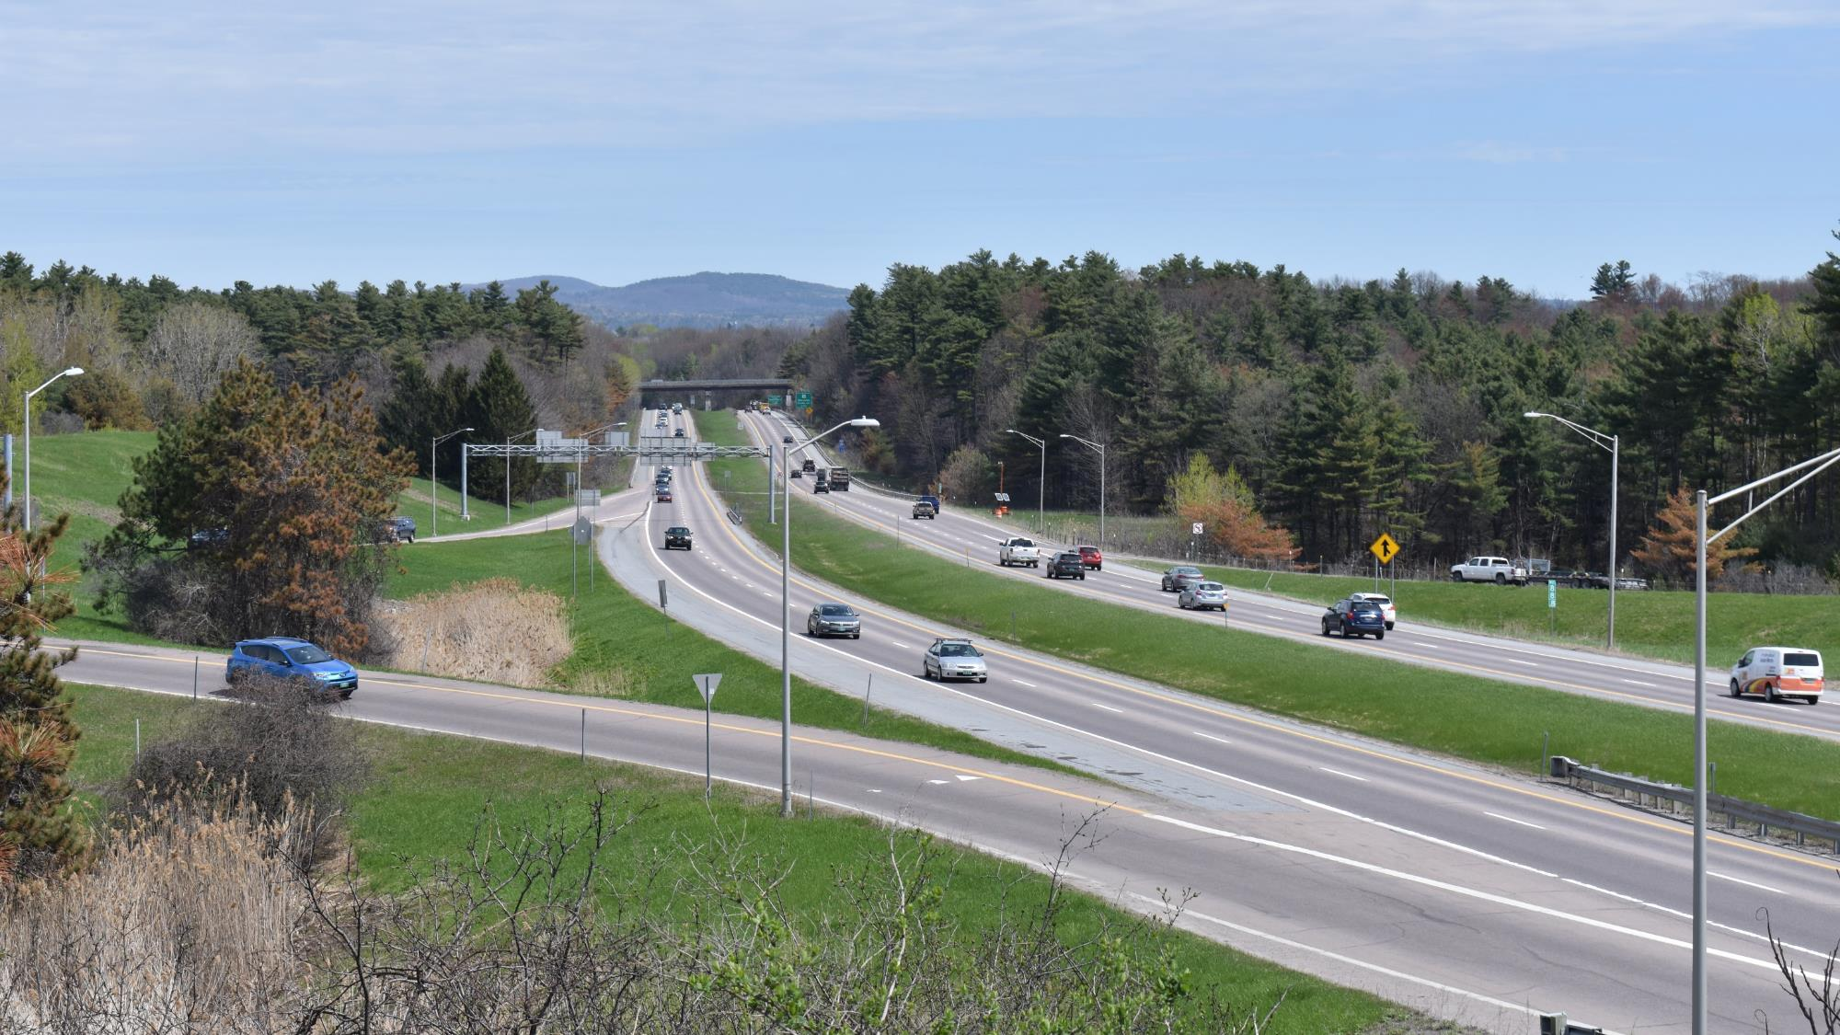

CCRPC Board Update
May 20th, 2020

Slide 2
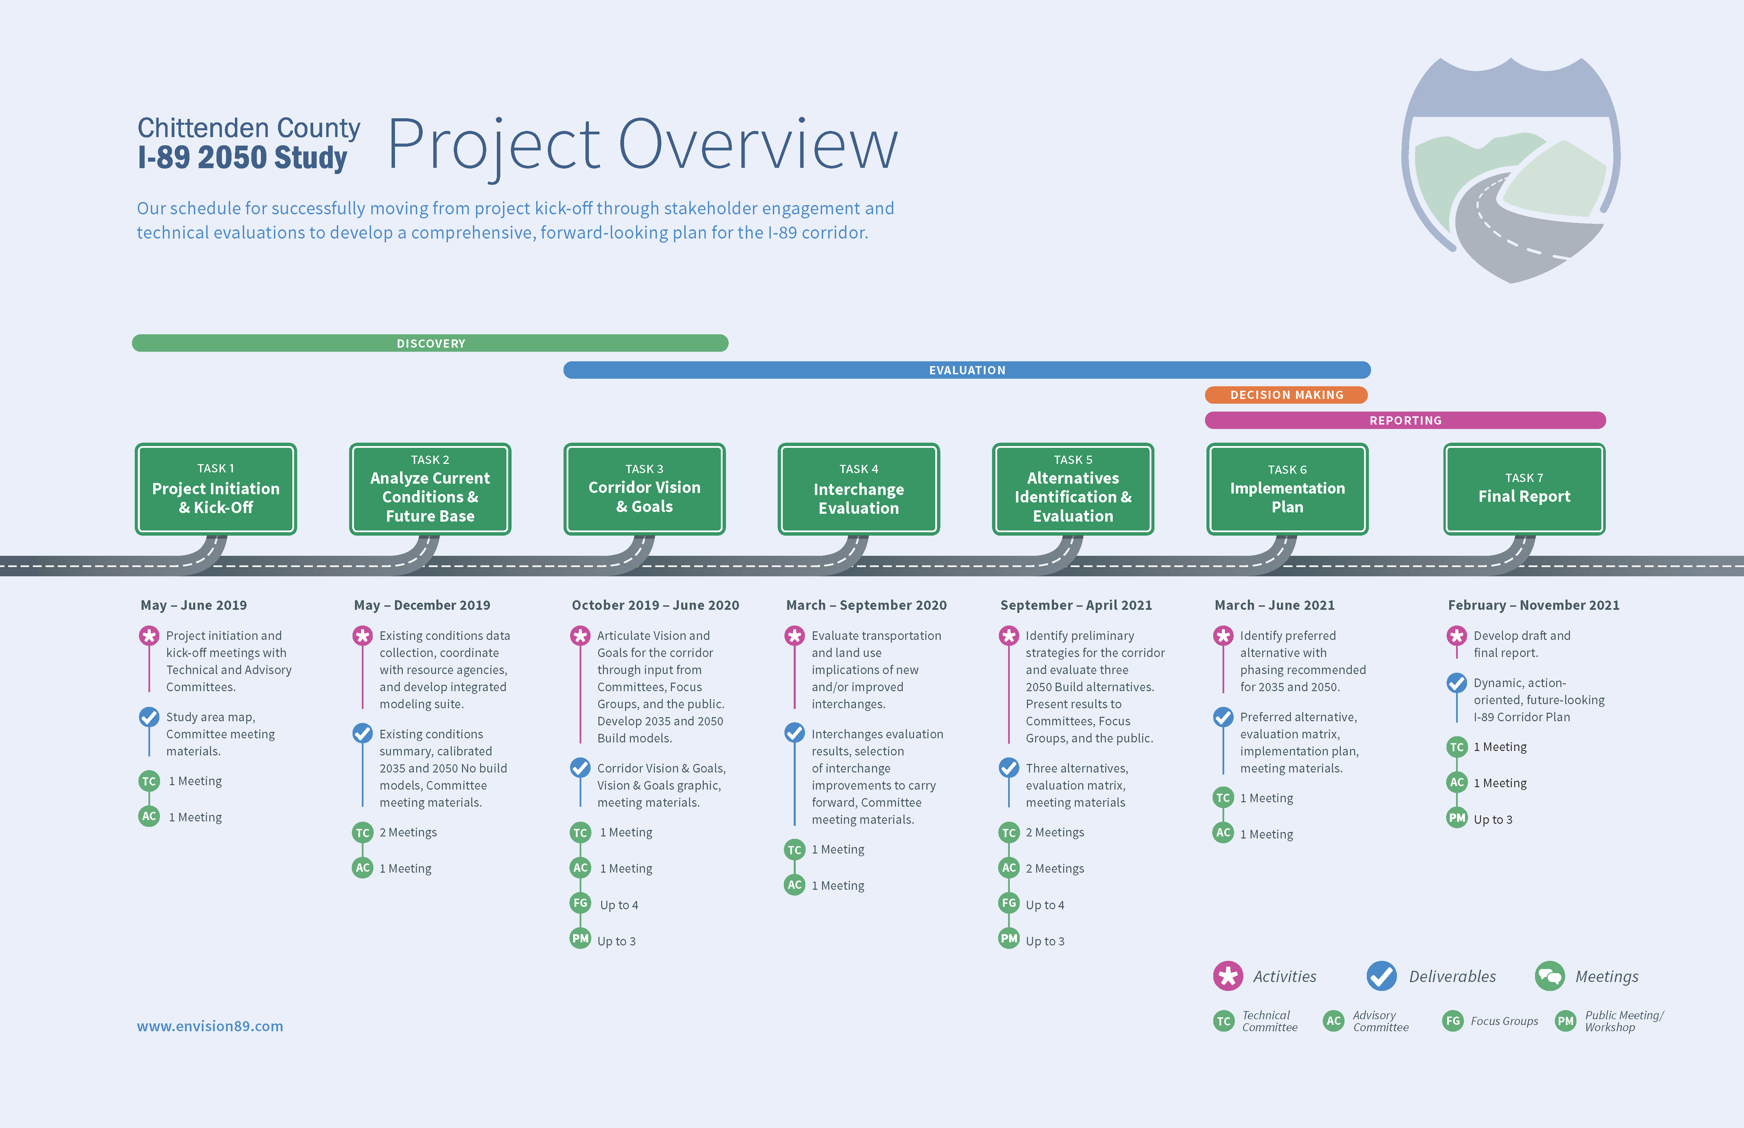


Slide 3
Completed Task 2
  Existing Conditions and Future Base Evaluation
Completed Task 3
  Refined Vision, Goals & Objectives
  Three Public Meetings & Stakeholder Engagement (CVRPC, ACRPC, South Burlington City Council)
Task 4
  First Round Interchange Screening Evaluation (7 Interchanges)
  Second Round Interchange Screening Evaluation (4 Interchanges)

Slide 4

Interchange Screening Evaluation
Two-step Process to Develop Recommendations for the I-89 Corridor Plan
  Interchange Recommendations
    First Round “High-Level” Interchange Screening
    Second Round Interchange Evaluation
  Full Recommendations (inclusive of interchanges and other improvements)
First Round “High Level” Interchange Screening
  High level screening of seven new or expanded interchanges: 10A (Bolton), 12B (VT116), Full 13, U-Turn on I-189, 14N (Airport), Full 15, 17N (Milton)
  Utilized previous interchange scoping / feasibility studies for interchange configuration, impacts, and cost
  Evaluation metrics tied to project goals
  Double weighting for metrics tied to Exit 14 impacts & consistency with Regional Plan

Slide 5
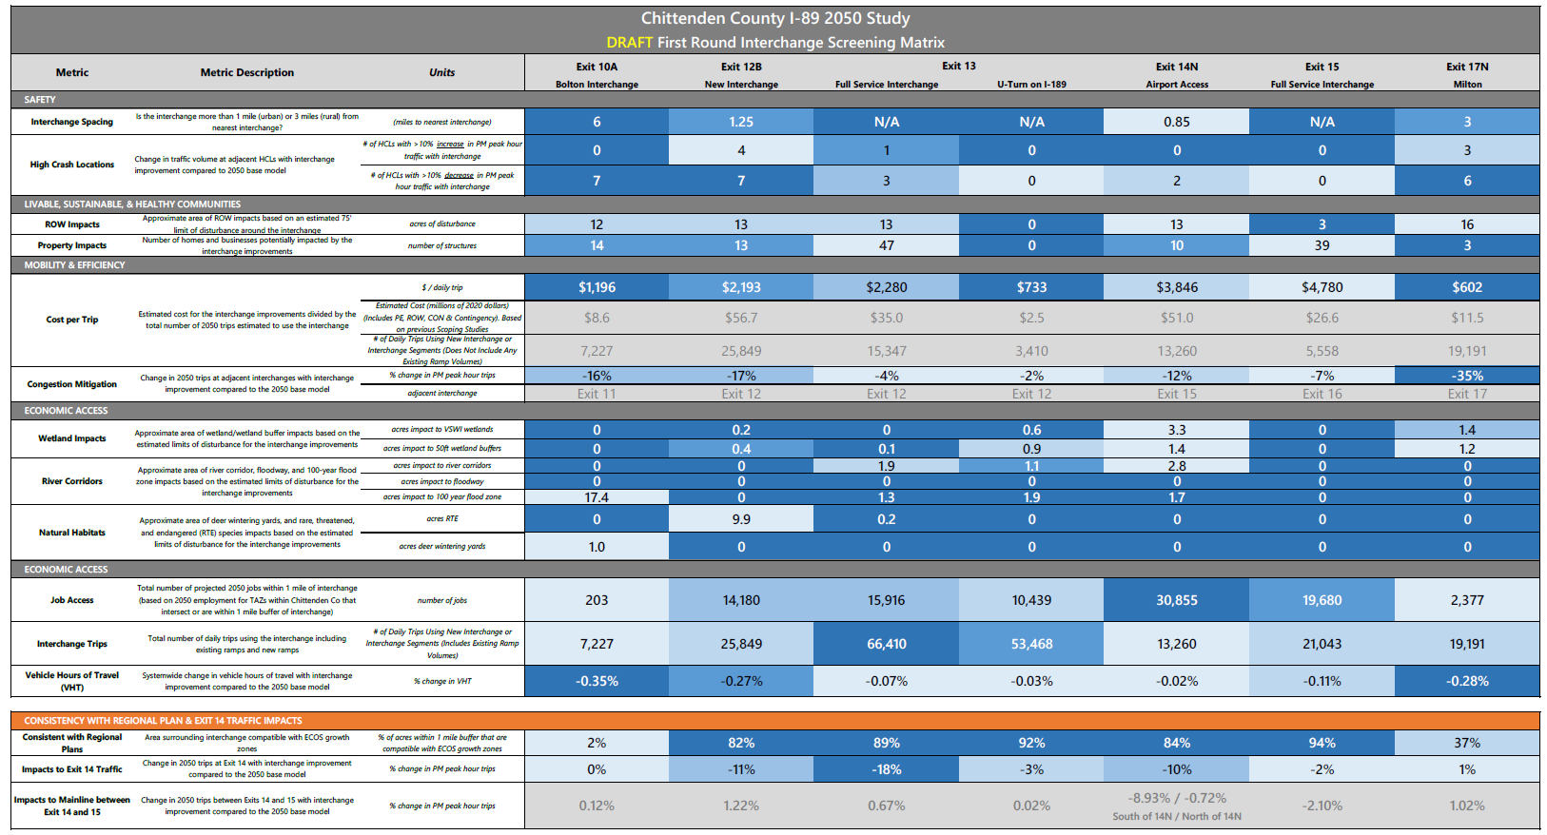
Draft First Round Interchange Screening Evaluation
Metric descriptions
Seven Interchanges
Evaluation metrics organized by Goals
Greyed-out rows provided for information only (i.e. not scored)
Each metric value assigned a score from 0 (white) to 4 (dark blue)
Double weighting of these metrics

Slide 6
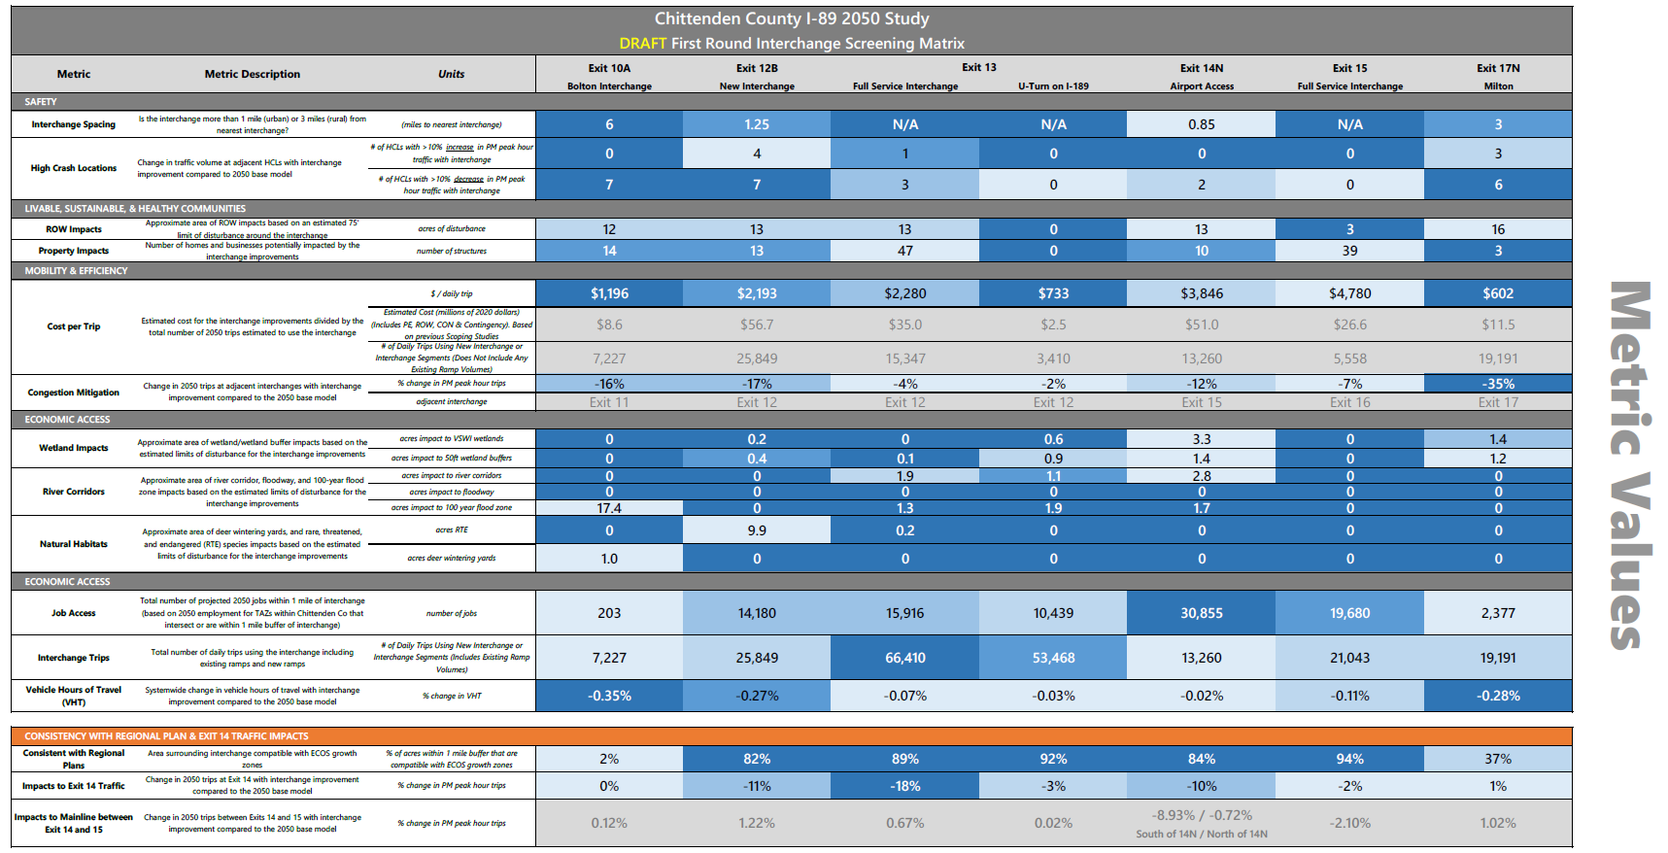
Draft First Round Interchange Screening Evaluation

Slide 7
Draft First Round Interchange Screening Evaluation

Slide 8
I-89 Technical Committee Recommendation & Next Steps
Interchanges to Move forward to Round 2 Evaluation:
  Exit 12B – New Interchange
  Exit 13 – Full Service Interchange
  Exit 14 Improvements
Recommendations will be presented to the South Burlington City Council for their input (early June)
Recommendations will be presented to the I-89 Advisory Committee for consideration and approval (end of June)

Slide 9
Thank you! https://envision89.com/

Slide 10
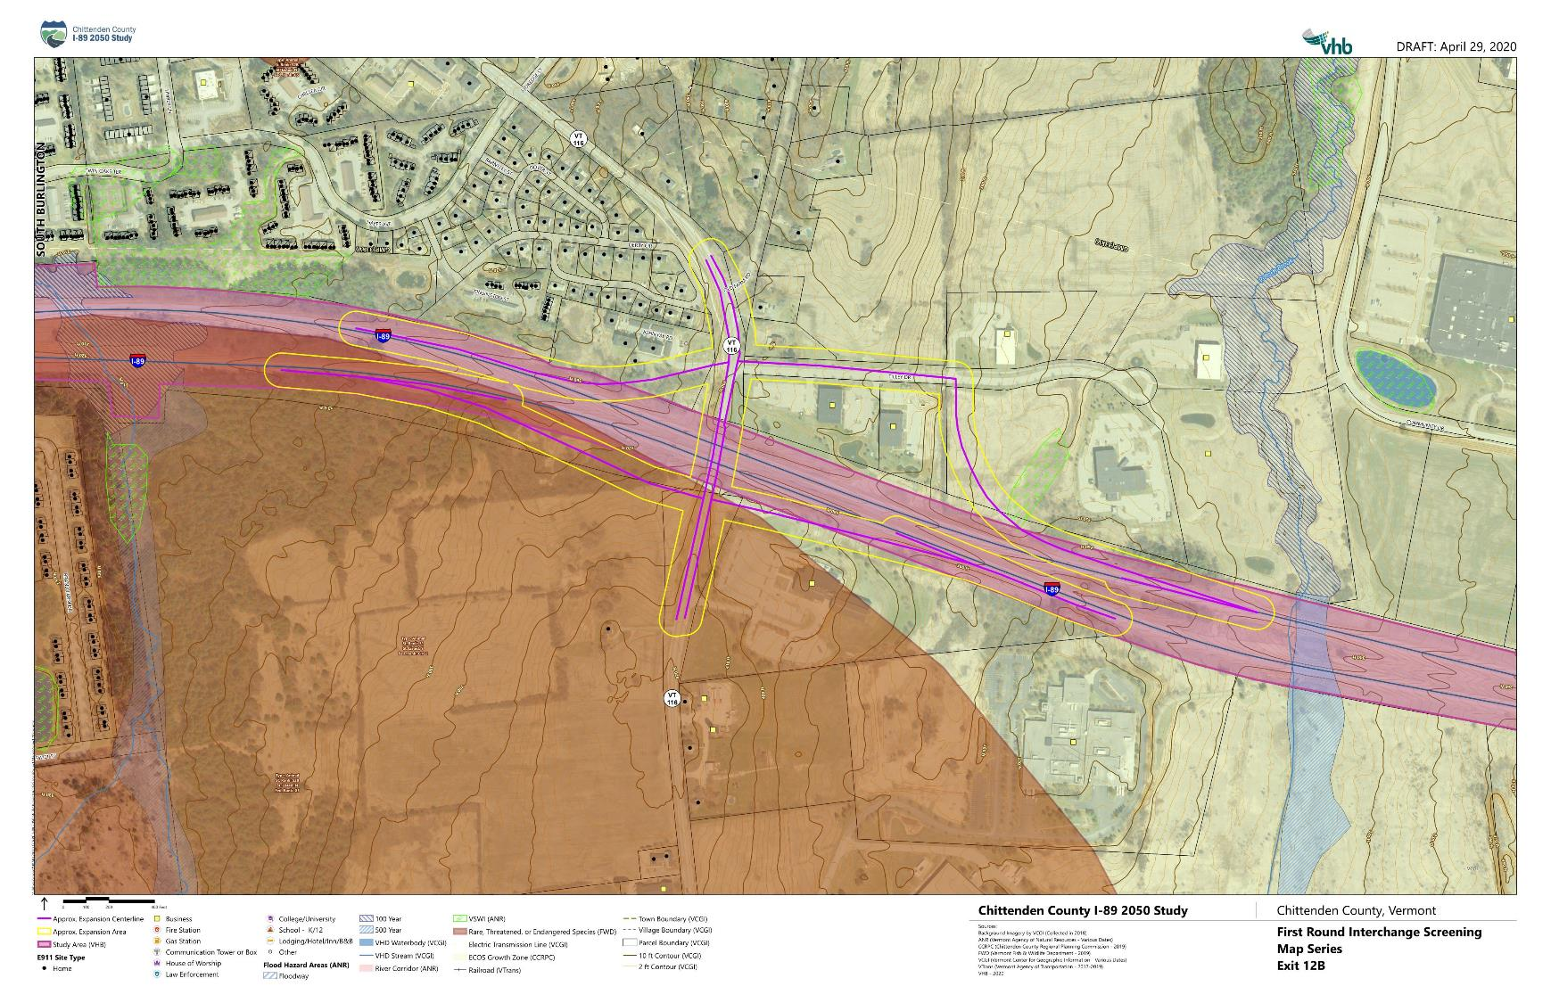

Slide 11
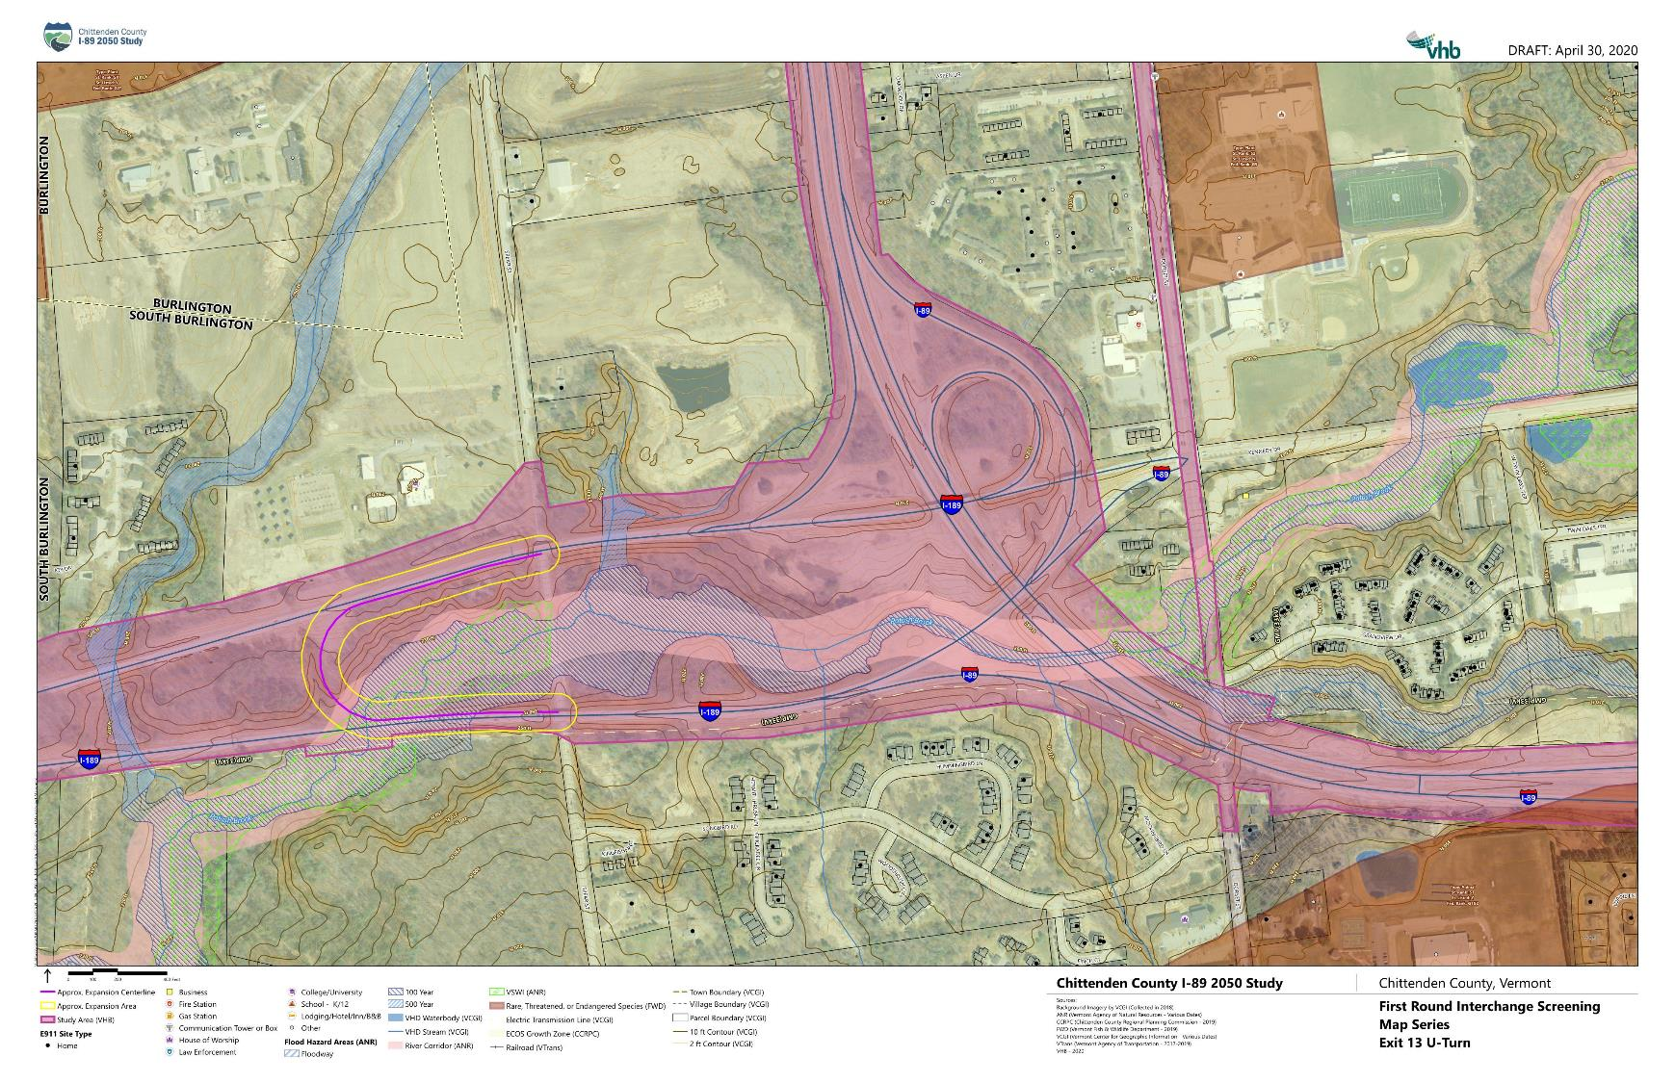

Slide 12
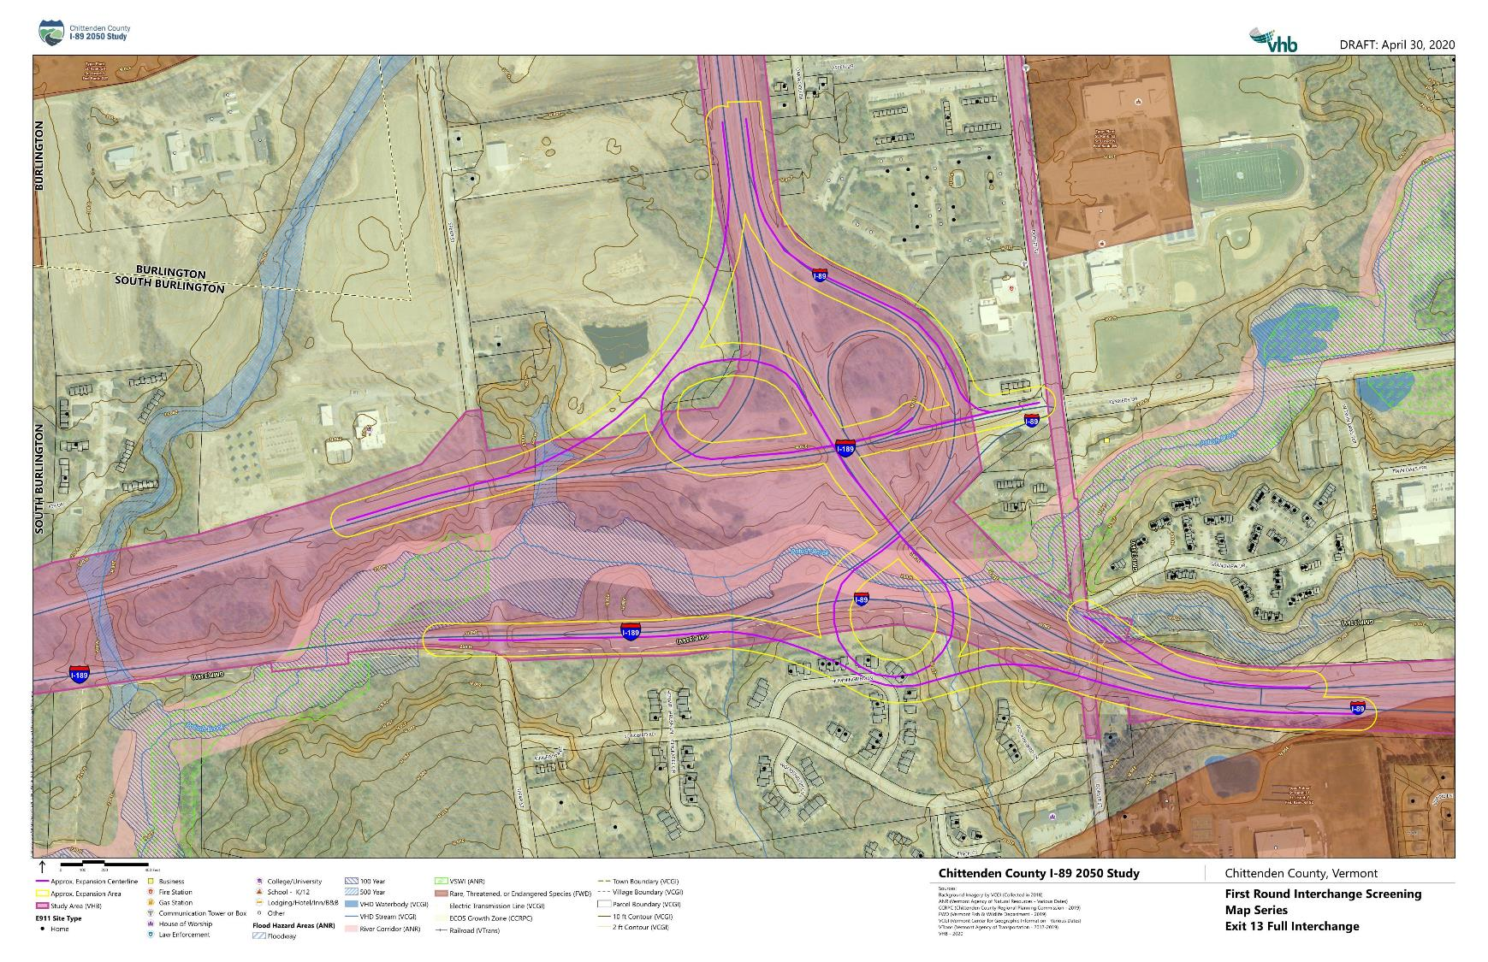

Slide 13
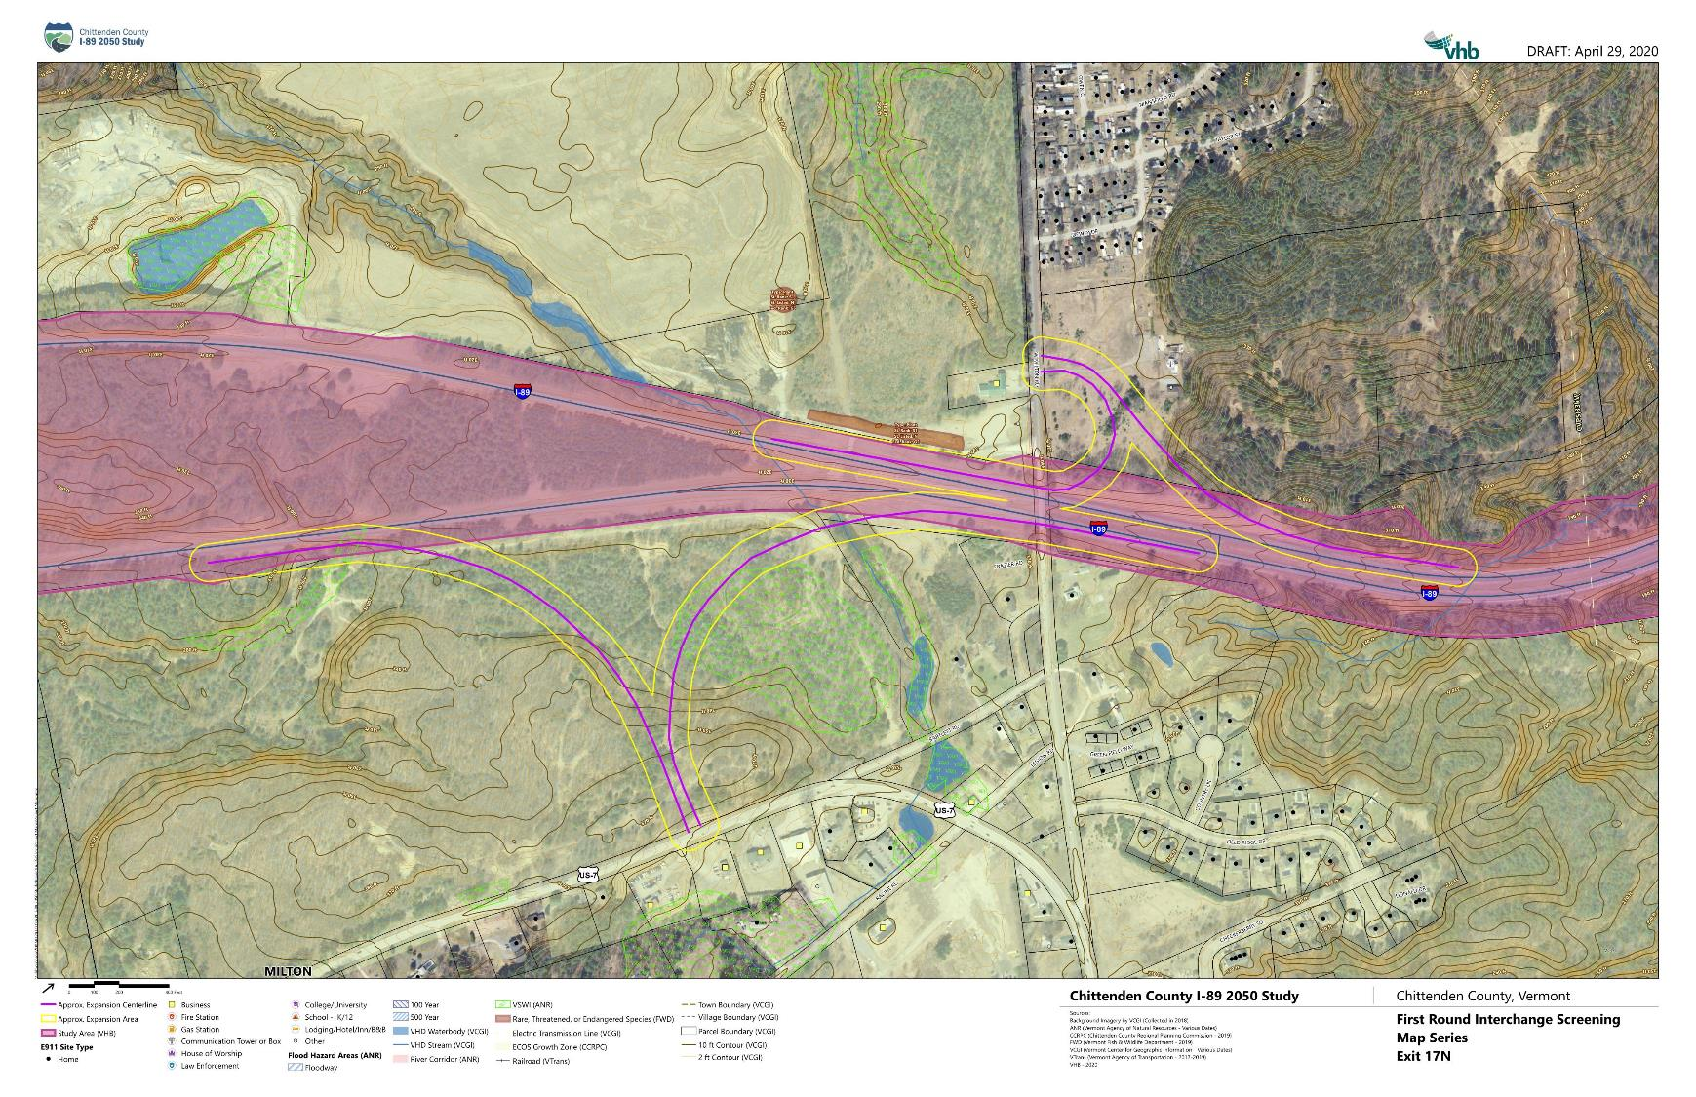

Slide 14
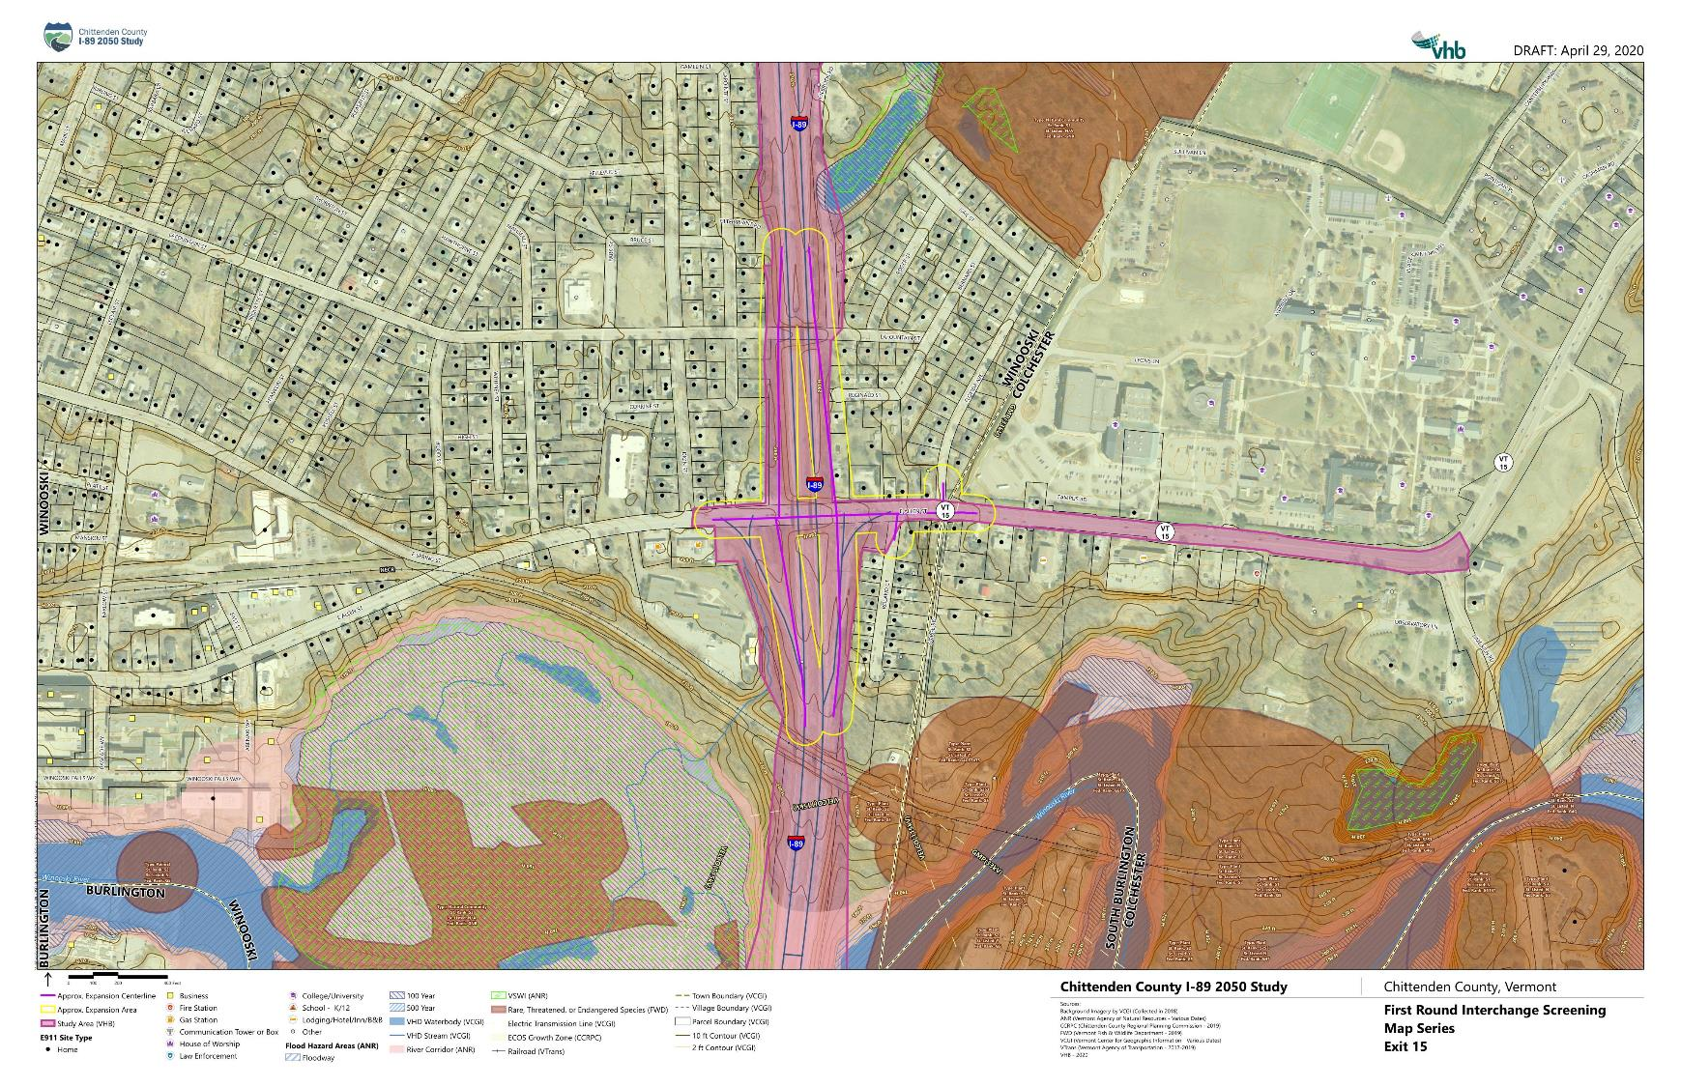

Slide 15
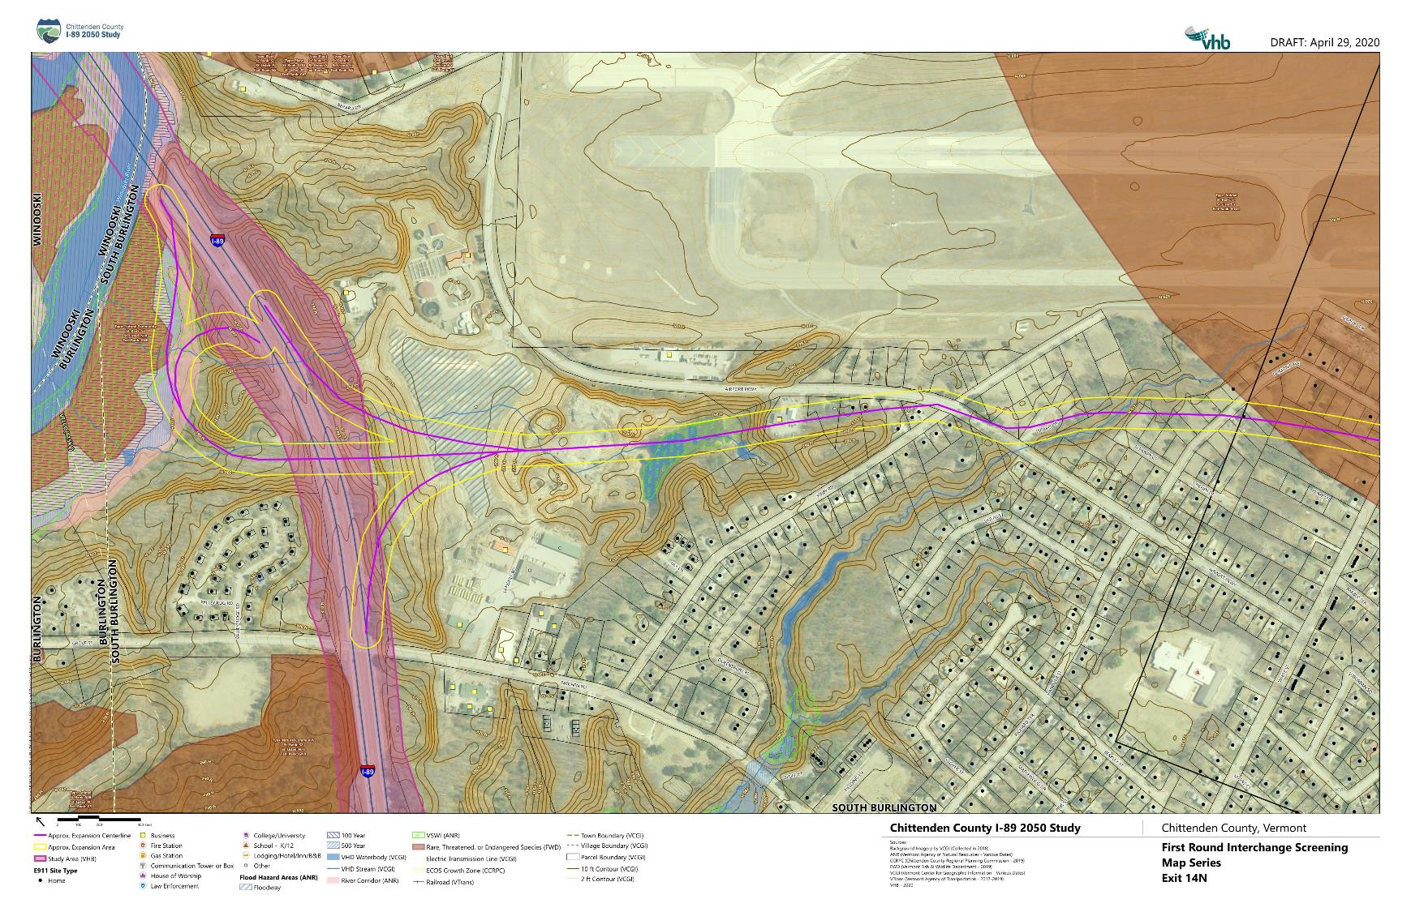

Slide 16
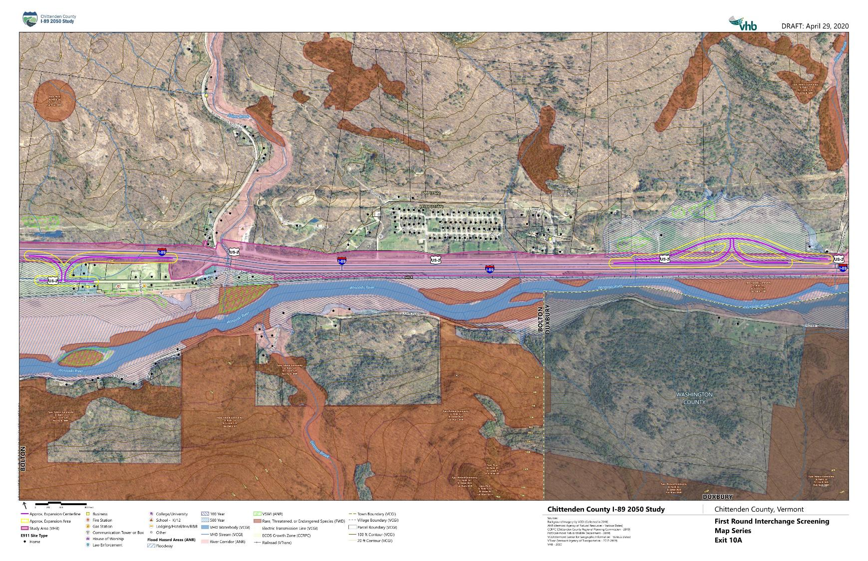

Slide 17
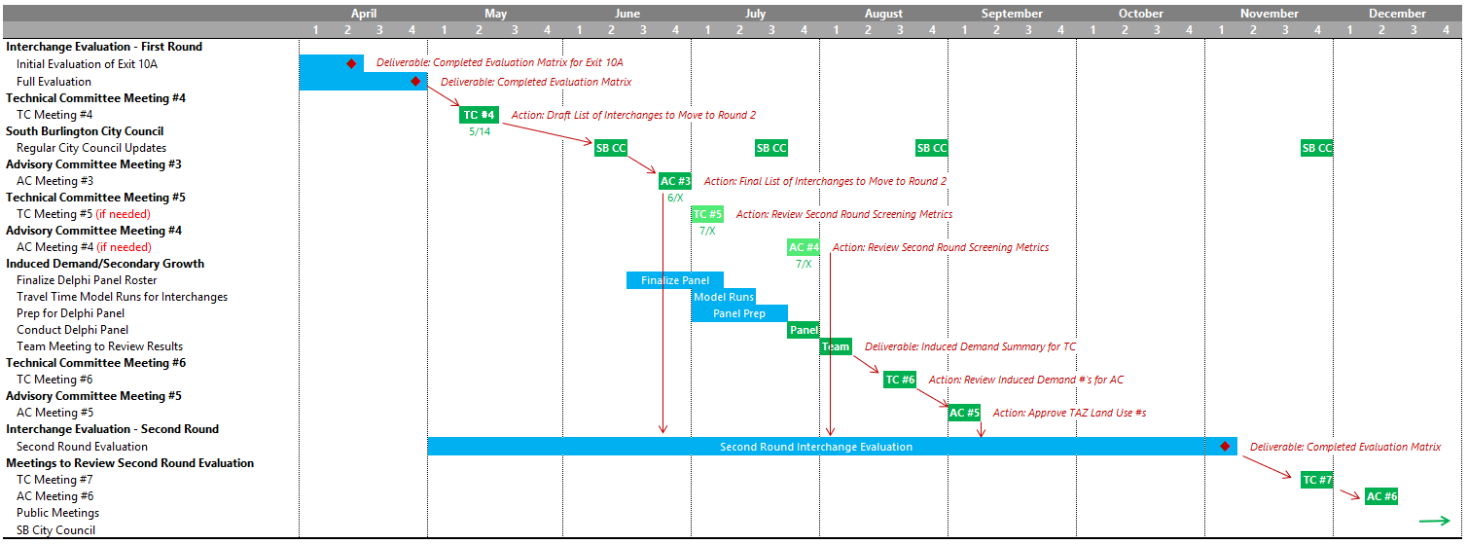
Next Steps
Presentation(s) to South Burlington City Council (ongoing)
Advisory Committee Meeting #3 (June)
  Finalize Vision, Goals, and Objectives
  Final List of 2-3 Interchanges to Advance to Second Round Evaluation
Delphi Panel (July)

Slide 18
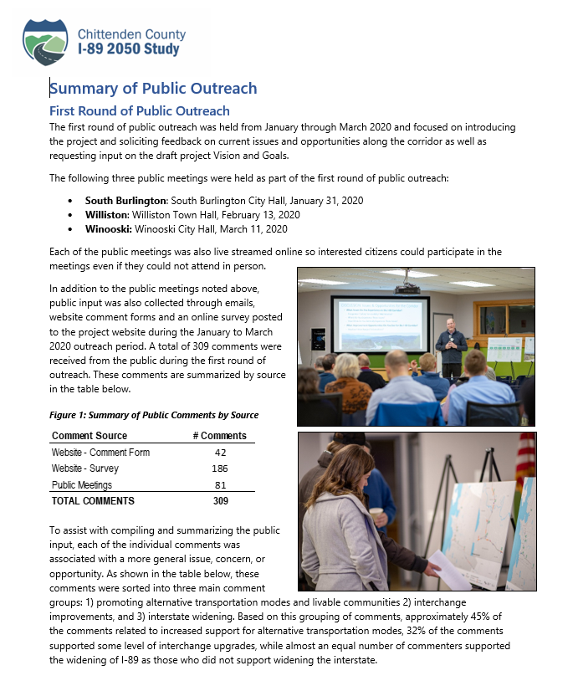
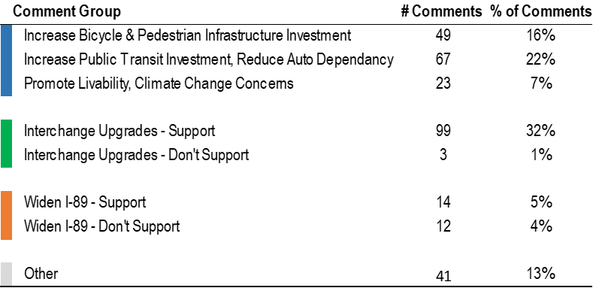
First Round Stakeholder & Public Input
Public Outreach
  South Burlington: January 31, 2020
  Williston Town Hall, February 13, 2020
  Winooski: Winooski City Hall, March 11, 2020
  Envision89.com
    Website Comment Form
    Website Survey
309 individual comments received

Slide 19
First Round Stakeholder & Public Input
Public Outreach
  South Burlington: January 31, 2020
  Williston Town Hall, February 13, 2020
  Winooski: Winooski City Hall, March 11, 2020
  Envision89.com
    Website Comment Form
    Website Survey
309 individual comments received

