Slide 1
CCRPC Board
I-89 Bundle 2: Transportation Climate Actions for Chittenden County
February 16th, 2022

Slide 2
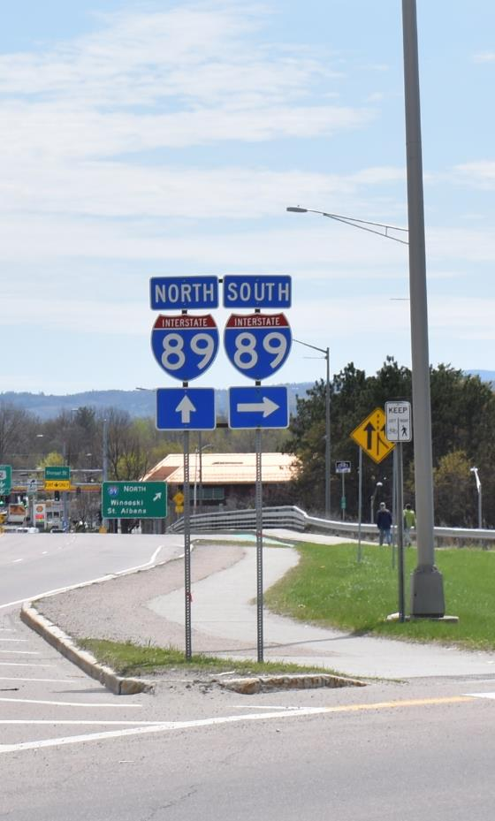
Presentation Contents
I-89 Project Background
I-89 Transportation Demand Management (TDM) Focus Group
Telework Evaluation
Strategic Model to assess investments & policies to decrease VMT & GHG Emissions
Strategic Model Evaluation & Results
Advisory Committee Action on Bundle 2
Next Steps

Slide 3
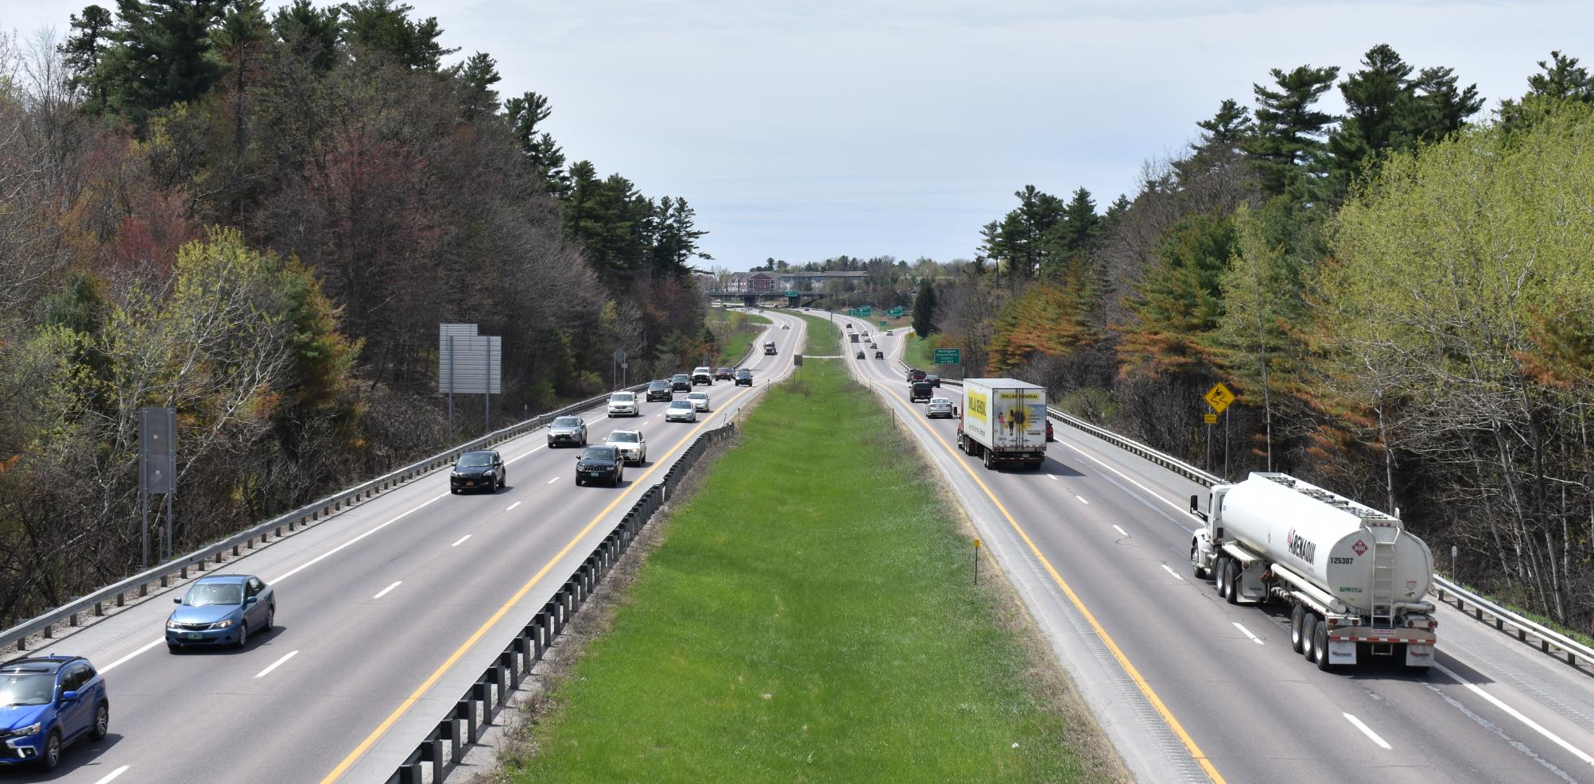
Project Background

Slide 5
Proposed I-89 Corridor Bundles (2050)
Investments | Bundle 1 No Build | Bundle 2 TDM / Bike/Ped / Transit | Bundle 3 Exit 14 DDI | Bundle 4 Exit 13 SPDI | Bundle 5 Exit 12B
CCRPC MTP Investments |  | ✓ | ✓ | ✓ | ✓
Public Transit (new service, increased frequency, etc.) |  | ✓ | ✓ | ✓ | ✓
Biking (lanes, paths, signals, etc.) |  | ✓ | ✓ | ✓ | ✓
Walking (sidewalks, paths, crosswalks, signals, etc.) |  | ✓ | ✓ | ✓ | ✓
Transportation Demand Management (park and ride lots, ridesharing, telecommuting, TMA, etc.) |  | ✓ | ✓ | ✓ | ✓
Intelligent Transportation Systems (signage, signals, etc.) |  | ✓ | ✓ | ✓ | ✓
Interchange Geometric & Safety Enhancements |  | ✓ | ✓ | ✓ | ✓
Exit 14 Diverging Diamond Interchange |  |  | ✓ | ✓ | ✓
Exit 13 Single Point Diamond Interchange |  |  |  | ✓
Exit 12B New Interchange |  |  |  |  | ✓
I-89 Third Lane (TBD) |  |  |  | ? | ?
Multimodal Operational Improvements
Capacity Expansion

Slide 6
I-89 Transportation Demand Management (TDM) Focus Group

Slide 7
I-89 TDM Focus Group Participants
Transportation Equity Coalition: Jill Allen, Billy Miles, Kirsten Nielsen
VTrans: Amy Bell, Dan Currier, Costa Pappis, Joe Segale
Town of Williston: Matt Boulanger
City of South Burlington: Justin Rabidoux
Green Mountain Transit: Jamie Smith, Chris Damiani
Burlington Electric Department: Jennifer Green
CATMA: Sandy Thibault
Local Motion: Jonathon Weber, Karen Yacos
Conservation Law Foundation: Dale Azaria
Sustainable Transportation Vermont: Jack Hanson
Staff: CCRPC, RSG, VHB

Slide 8
I-89 Corridor TDM Focus Group Role
Assisted with defining Bundle 2
Acted as advisory committee for Strategic Model
Met three times to inform policies and investments to evaluate:
Where to apply policies
What assumptions and values should be tested
Reviewed results of the Strategic Model and Telework evaluation
Provided direction on policies and investments to advance

Slide 9
Telework Evaluation

Slide 10
Telework Evaluation Summary
A methodology was developed to estimate the most probable scenario for percent VMT reduction (post pandemic) due to teleworking
Reviewed national data of teleworking trends for three work categories (professional, mixed, on-site) from February to December 2021
Established the percent of employees in the greater Burlington region that fall within each of the categories using Bureau of Labor Statistics data
Developed commuter breakdown of travel
Investigated two future scenarios and selected the most probable one

Slide 11
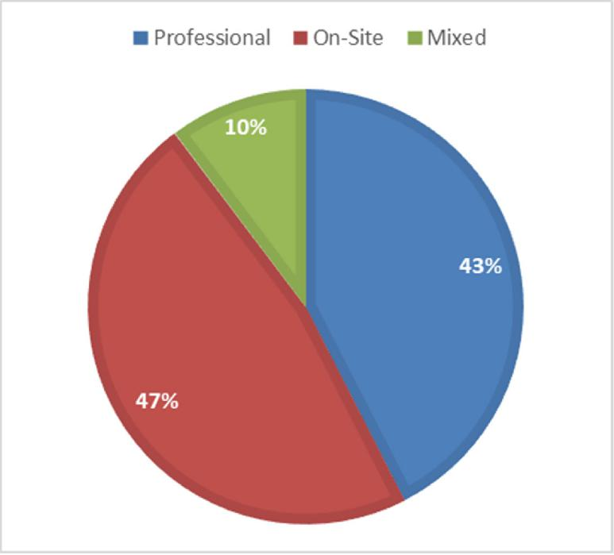
Job Category Mix in Study Area
Professional
Management
Business and financial operations
Computer and mathematical
Architecture and engineering
Legal
Educational instruction and library
Arts, design, entertainment, sports, and media
Office and administrative support
Mixed
Transportation and material moving Life, physical, and social science Community and social service
On-Site
Healthcare practitioners and technical
Healthcare support
Protective service
Food preparation and serving related
Building and grounds cleaning and maintenance
Personal care and service
Sales and related
Farming, fishing, and forestry
Construction and extraction
Installation, maintenance, and repair
Production
7
Notes:
Only feasible for roughly half the population to telecommute
Source: https://www.bls.gov/regions/new-england/news-release/occupationalemploymentandwages_burlington.htm

Slide 12
Greater Burlington Region: Commuter Travel Breakdown (Pre-pandemic)

Slide 13
Possible VMT Reductions due to Teleworking
Scenario 1
~11% reduction in daily commuter VMT
Approximate 50% increase in telework participation
Scenario 2
~ 52% reduction in daily commuter VMT
Based off initial pandemic state of emergency

Slide 14
Strategic Model

Slide 15
Why a Strategic Model for Bundle 2?
Best tool to evaluate policies and investments to reduce vehicle miles traveled (VMT) and greenhouse gas emissions (GHG)
Strategic model is an econometric model that is sensitive to:
variety of policies and investments that affect household travel
multiple modes of travel (bus, walk, taxi, bike)
how travel may be constrained by pricing (e.g., gas, carbon, VMT tax)
Notes:
The current regional travel model is insensitive to many of the policies and investments that are being considered in the TDM bundle. Aspects of travel demand management,
Do you want to point them to the VisionEval.org website for more information?

Slide 16
Summary of Strategic Model Process
I-89 TDM Goals
Reduce VMT and GHG in support of the I-89 Goals
Key Drivers of Change
Policies &
Outcomes & Metrics
GHG Emissions
Multimodal travel
Technologies:
Land Use
Electrification
Pricing
Climate Change
Investment Packages
Land Use
Demand Management & Parking Pricing
Taxes (Gas, Carbon) & Fees (VMT)
Income Distribution
Fleet Electrification
VMT
Etc.
Bike/Ped Share
Transit Improvements
Bike & Transit

Slide 17
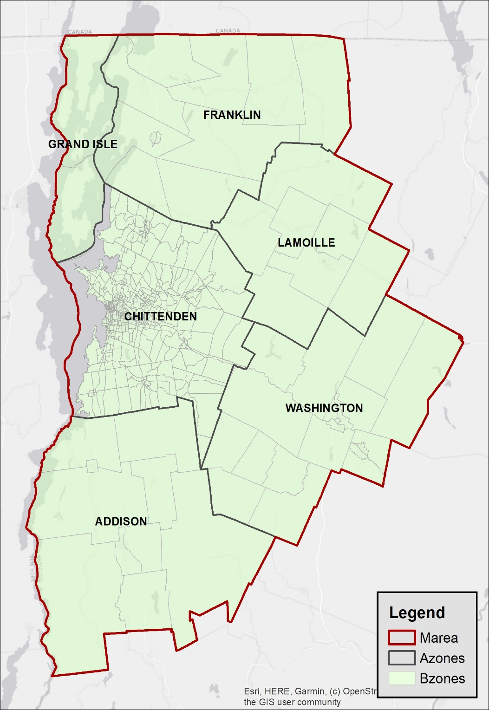
Strategic Model Area
Chittenden County and surrounding five counties
Increased granularity in Chittenden County
Notes:
Census Tracts largely follow municipal boundaries outside of CC.

Slide 18
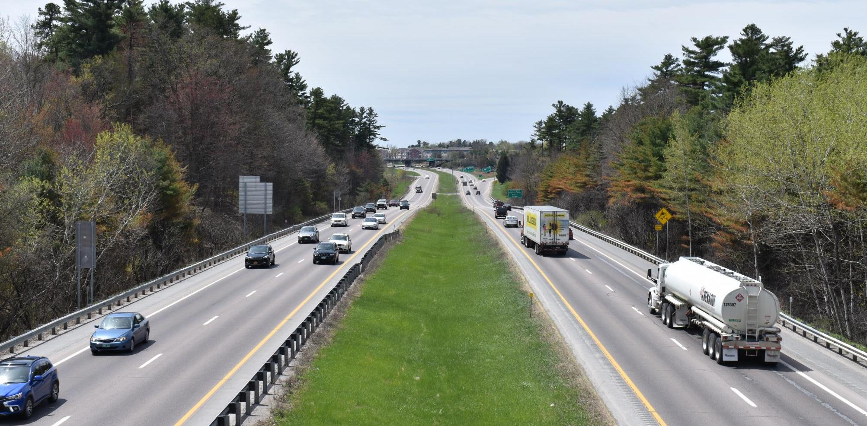
Strategic Model
Evaluation & Results

Slide 19
Scenario Testing Structure
Land Use & Community Design
Bike & Transit
Demand Management
Pricing
Income
Commercial Vehicles
1
2
Each policy or investment option has different levels which are evaluated
The Strategic Model runs all the combinations of levels within the six options
Levels
3
4

Slide 20
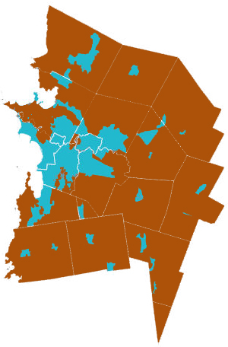
Scenario Testing Structure
Land Use & Community Design
Bike & Transit
Demand Management
Pricing
Income
Commercial Vehicles
1
Base – CCRPC’s Metropolitan Transportation Plan
2
90% of household growth in areas planned for growth
Walking & biking infrastructure expansion
Transit route additions and frequency increases
Transportation Demand Management
90% of personal vehicles (including light trucks) are electric
Levels
3
4

Slide 21
Scenario Testing Structure
Land Use & Community Design
Bike & Transit
Demand Management
Pricing
Income
Commercial Vehicles
1
Base – no change from CCRPC’s Metropolitan Transportation Plan
2
Land Use 2
10% increase in population and housing in Chittenden County
Community Design
50% increase in mixed use neighborhoods and walkability
Levels
3
4

Slide 22
Scenario Testing Structure
Land Use & Community Design
Bike & Transit
Demand Management
Pricing
Income
Commercial Vehicles
1
Base – no change from CCRPC’s Metropolitan Transportation Plan
2
Double Bike Trips
Transit L2
50% increase in frequency and miles of service
Levels
3
Double Bike Trips
Transit L3
100% increase in frequency
200% increase in miles of service
4

Slide 23
Scenario Testing Structure
Land Use & Community Design
Bike & Transit
Demand Management
Pricing
Income
Commercial Vehicles
1
Base – no change from CCRPC’s Metropolitan Transportation Plan
2
Double TDM
2X participation in programs such as guaranteed ride home, carpooling, vanpooling
Parking L2
50% reduction in residential parking spaces
Expansion of paid parking areas in downtowns
Levels
3
Double TDM
50% reduction in residential parking spaces
Expansion of paid parking to villages with a moderate increase in pricing
Parking L3
4

Slide 24
Scenario Testing Structure
Land Use & Community Design
Bike & Transit
Demand Management
Pricing
Income
Commercial Vehicles
1
Base – no change from CCRPC’s Metropolitan Transportation Plan
2
Carbon Tax
$50/ton CO2 equivalent
Levels
3
Double cost of fuel
Includes gasoline, diesel, and electricity for electric vehicles.
4
Mileage-based Fee
5¢ per mile
Notes:
Reminder that it’s 2050 and 90% of vehicles are electric.
All dollars are current year dollars.

Slide 25
Scenario Testing Structure
Land Use & Community Design
Bike & Transit
Demand Management
Pricing
Income
Commercial Vehicles
1
Base – no change from CCRPC’s Metropolitan Transportation Plan
2
Decrease the household budget and amount eligible to spend on transportation. Pushes people towards less expensive modes.
Smaller Middle Class
Levels
3
Larger Middle Class
Increases the household’s income and budget that can be spent on transportation
4

Slide 26
Scenario Testing Structure
Land Use & Community Design
Bike & Transit
Demand Management
Pricing
Income
Commercial Vehicles
1
Base – no change from CCRPC’s Metropolitan Transportation Plan
2
Decreased cost of ride-hailing. Increase EVs
Service areas are also expanded for carshare and Ride-hailing (e.g., taxi’s, Uber, Lyft)
95% of commercial vehicles are electric
Levels
3
4

Slide 27
Scenario Testing Structure
Land Use & Community Design
Bike & Transit
Demand Management
Pricing
Income
Commercial Vehicles
1
Base – no change from CCRPC’s Metropolitan Transportation Plan
2
Land Use 2
Double Bike Trips
Double TDM
Carbon Tax
Smaller Middle Class
Decreased cost of ride-hailing. Increase EVs
Community Design
Transit L2
Parking L2
Levels
3
Double Bike Trips
Double TDM
Double cost of fuel
Larger Middle Class
Transit L3
Parking L3
4
Mileage-based Fee

Slide 28
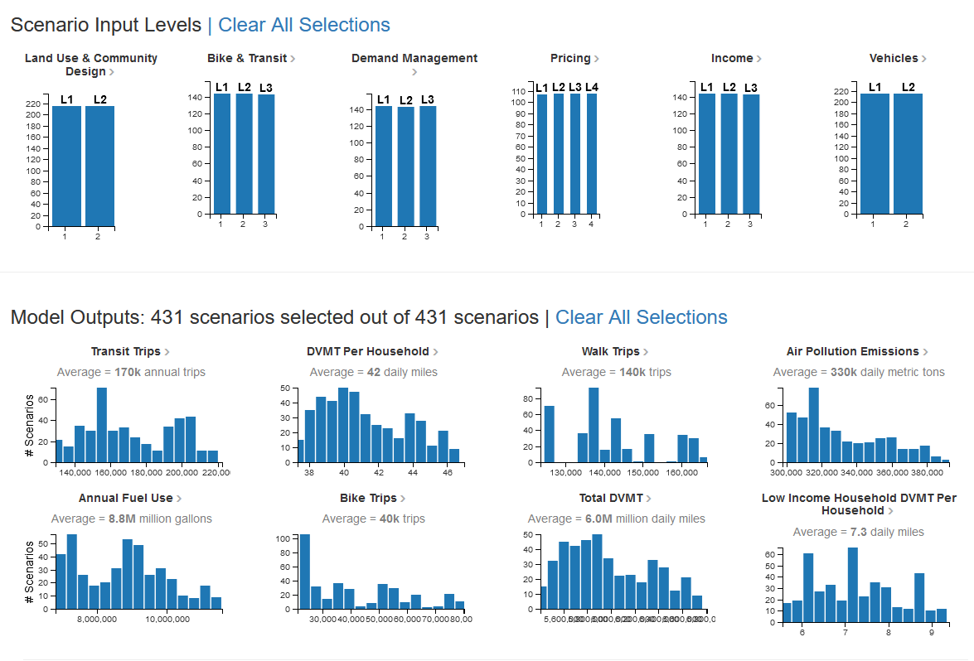
Strategic Model Outputs

Slide 29
How is the Strategic Model Used
Not a prediction or forecast of the future
If we want low VMT/GHG, what policy and investment options are most likely to get us there?

Slide 30
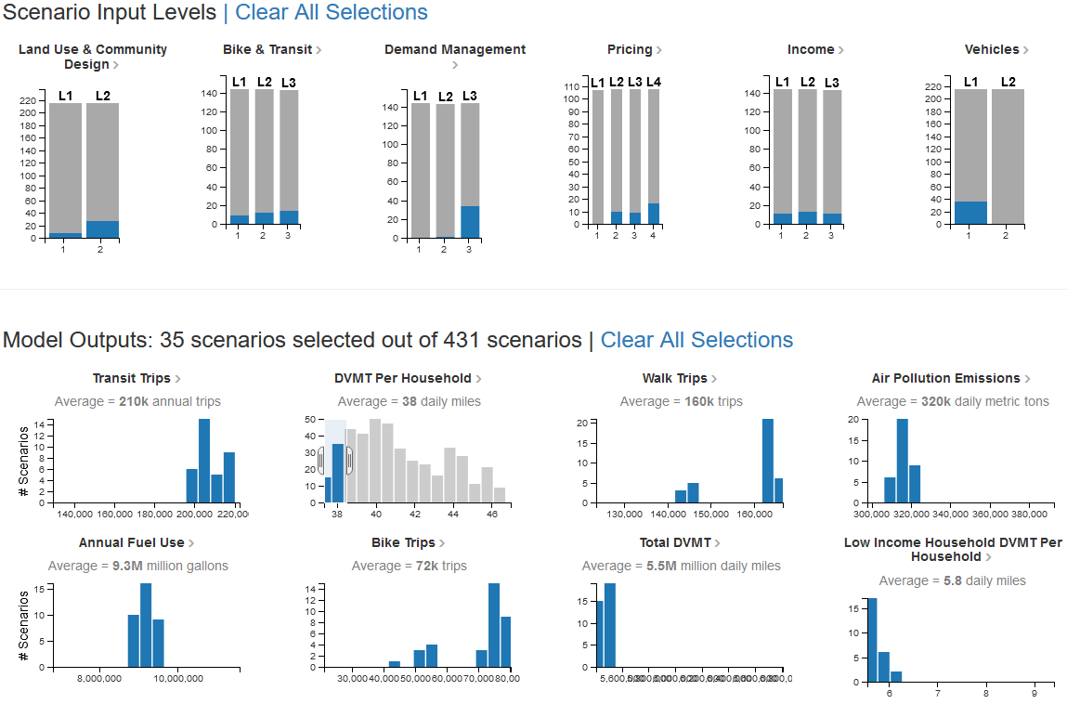
Strategic Model Results

Slide 31
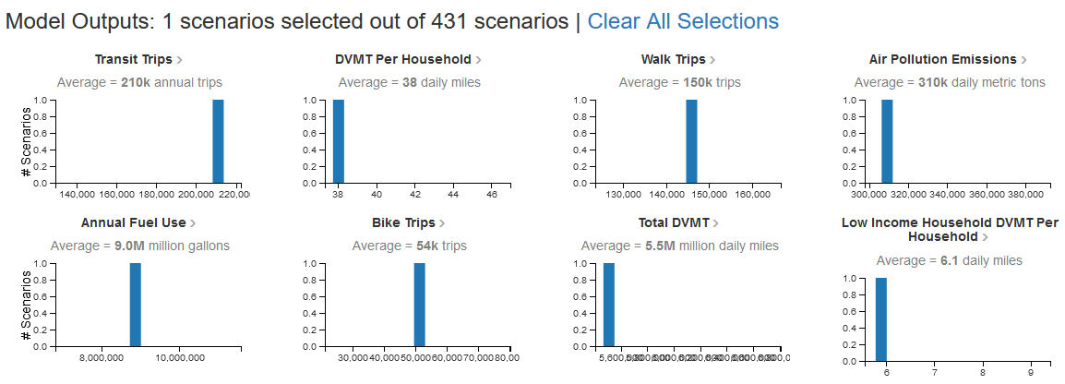
Strategic Model Results – Low Vehicle Miles Traveled (VMT) Scenario

Slide 32
Low Vehicle Miles Traveled (VMT) Scenario
Land Use & Community Design
Bike & Transit
Demand Management
Pricing
Income
Commercial Vehicles
1
Base – no change from CCRPC’s Long Range Transportation Plan
2
Increase EVs
Community Design
Levels
3
Double Bike Trips
Double TDM
Transit L3
Parking L3
4
Mileage-based Fee
Notes:
All of these need to happen together in order to have the greatest outcome of achieving this future.

Slide 33
Recommended Policies & Investments to be included in Bundle 2
Increase teleworking by 50%
MTP land use density (90% of Households in existing developed areas)
Double trips made by bike
Triple transit services and improve frequencies
Double participation in TDM programs and increase cost of parking
Mileage-based fee (5 cents/mile)
Total VMT reduction between 10% and 20%

Slide 34
Public Feedback from Jan 26th Public Meeting
Numerous questions on the inputs/data used for the Strategic Model; how the model was used; and interpretation of the outcomes
See the Meeting Notes and the Question & Answer document on the Envision89 website (https://envision89.com/public-process)
Public expressed thanks for this work & attention given to climate-friendly infrastructure & policies

Slide 35
Advisory Committee Action on Bundle 2
The I-89 Advisory Committee at their February 8th meeting voted unanimously to support further evaluation of the recommended policies and investments for Bundle 2

Slide 36
Next Steps

Slide 37
I-89 Study Next Steps
Use the relevant strategic model outputs and telework VMT reductions to develop the Bundle 2 travel demand model.
Use Bundle 2 travel demand model as the base to run Bundle 3 (Exit 14 DDI), Bundle 4 (Exits 14 DDI & 13 SPDI), and Bundle 5 (Exits 14 DDI & 12B); I-89 mainline capacity will also be evaluated for all Bundles
Next Public meeting: April/May to review results of all Bundles
Next Advisory Committee in May
Milton and Bolton Interchanges technical assessment report forthcoming

Slide 38
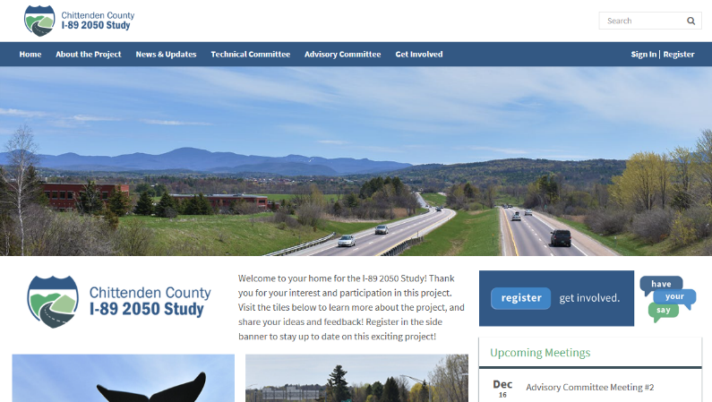
Please reach out to us if you would have questions or comments.
Charlie Baker: cbaker@ccrpcvt.org
Eleni Churchill: echurchill@ccrpcvt.org
Web: www.envision89.com
Twitter: @envision89
Facebook: Envision89

