Slide 1
West Central Vermont
Comprehensive Economic Development Strategy (CEDS)

Slide 2
Objectives
Explain West Central Vermont CEDS Project Partnership
Review Draft CEDS
Engagement
Review Timeline

Slide 3
What is a CEDS?
A strategy-driven plan for regional economic development
US Economic Development Administration (EDA) Requirements
Economic Profile/Summary
SWOT Analysis
Strategic Direction/Action Plan
Evaluation Framework (Indicators)
Must Address “Economic Resilience”
Notes:
The National Association of Counties (NACO) describes economic resilience as ”a community’s ability to foresee, adapt to, and leverage changing conditions to their advantage.”
Similarly, the U.S. Economic Development Administration’s (EDA) Comprehensive Economic Development Strategy (CEDS) Content Guidelines note that resiliency has three primary attributes:
The ability to recover quickly from a shock;
The ability to withstand a shock; and
The ability to avoid the shock altogether

Slide 4
What is West Central Vermont?
Four sub-regions:
Addison County (except Granville and Hancock)
Chittenden County
Central Vermont (Washington County plus Orange, Washington, and Williamstown in Orange County)
Rutland County (except Pittsfield)
90 Municipalities

Slide 5
Why Write a CEDS?
Collaboration and Coordination
Inform Regional Plans
Cross sector coordination and collaboration
Equity
Potential Economic Development District (EDD)
Additional EDA Funding Opportunities
Three Sub-regions do not have a CEDS
CCRPC/GBIC sub-region has a CEDS
Notes:
EDA Funding Opportunities:
American Rescue Plan Act – TBD. Likely the following kids of projects:
Preparation of economic development recovery and resiliency plans
Construction of infrastructure that supports economic development
Entrepreneurial programs and facilities
Projects for communities to address pandemic-related economic losses in the tourism sector (25% of the funding will be directed for this purpose
Planning and Technical Assistance – “developing economic development plans and studies designed to build capacity and guide the economic prosperity and resiliency of an area or region.”
Public Works and Economic Adjustment Assistance – Planning or construction – projects that lead “to the creation and retention of jobs and increased private investment, advancing innovation, enhancing the manufacturing capacities of regions, providing workforce development opportunities, and growing ecosystems that attract foreign direct investment.”
Build to Scale (B2S) - to build regional economies through scalable startups.
Venture Challenge
Capital Challenge
Industry Challenge
Disaster Supplemental – Disaster resilience planning and related public and private infrastructure.

Slide 6
Work to Date
Outreach and Engagement
Workshop
Focus Groups
Employer Survey
Economic Profile
SWOT/SOAR
Draft EDD Bylaws
Draft CEDS

Slide 7
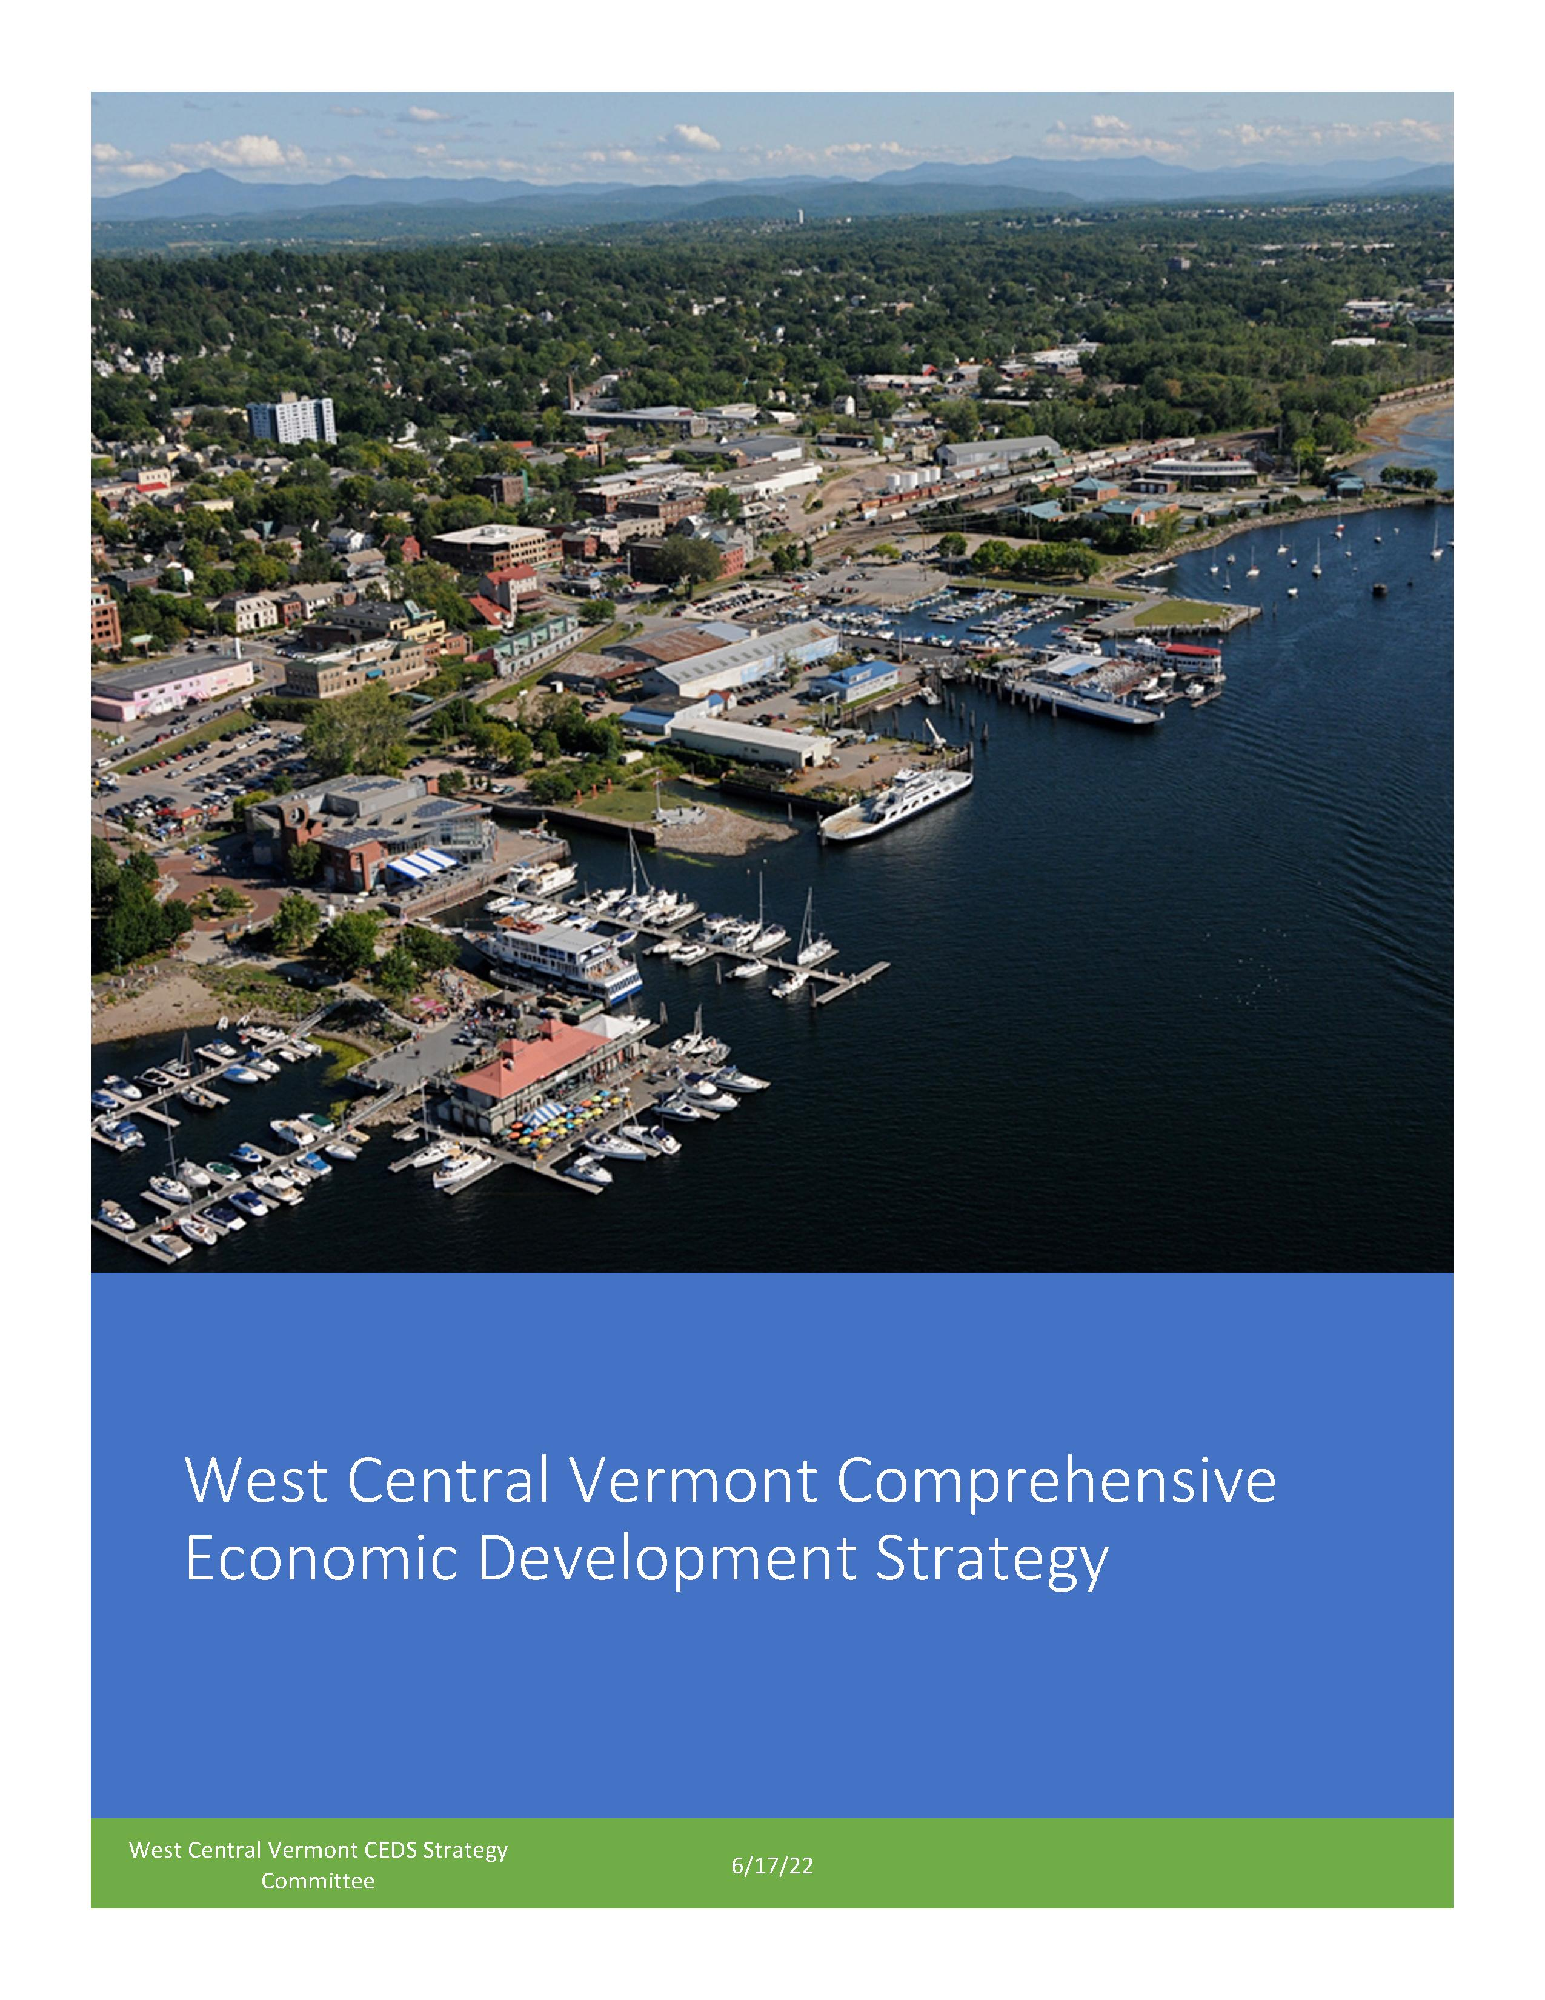
Draft CEDS
Draft available at: https://www.westcentralvt.org/
Soliciting comments via:
Konveio
Email at info@westcentralvt.org
Comments due: August 12, 2022
Final Draft: Complete by end of September 2022

Slide 8
CEDS – Key Findings
West Central Vermont is the most economically impactful region of Vermont. The Region’s geographic size, population, economic base, GDP, personal income, level of education, and infrastructure set it apart from the rest of the State.
Growth centered in Chittenden County
Diversity
Between 2010 and 2020, the White alone population declined. The population of all other racial groups increased by 95% over the same period (21,020 persons in 2010 to 40,949 persons in 2020).
COVID Response
Federal Assistance – $11.3 billion to State/businesses/individuals in Vermont
Most severe, direct, and lasting impact on the Leisure and Hospitality supersector of the economy. Total employment in the supersector remained down 16% in December 2021 compared to December 2019.
Total employment in the Retail sector remains down 6% and the Manufacturing supersector remains down 7%. Total employment in theses economic sectors did not improve on a month-to-month basis in 2021.
The Region has generally emerged from the pandemic in a strong economic position. Personal income is up, wages have increased, consumption is strong, and job opportunities are plentiful (see Resilience subsection)

Slide 9
CEDS – Key Findings
Economic stability and long-term growth are challenged due to a labor shortage.
The labor force participation rate in Vermont (60.9%) is at its lowest point in over 40 years.
The Region has high location quotient values for niche manufacturing and value-added agricultural products
But the manufacturing sector has generally not added jobs at the same rate as other sectors, and wage growth in manufacturing has been slower than in all other sectors, since 2010 (see Regional and Sub-regional Economy subsection).

Slide 10
CEDS – Key Findings
The West Central Vermont Region is not immune to economic inequity that exists in the rest of Vermont and the country.
Gender wage gap
Gaps between White residents and BIPOC residents in education attainment, income, and homeownership rates all exceed national averages
Investing in infrastructure in areas planned for growth is a regional priority.
Supports economic development, but also housing and essential services

Slide 11
CEDS Goals
Attract New Workers and Expand Labor Force
Equity
Business Development and Job Creation
Workforce Development and Employee Retention
Infrastructure and Resilience
Quality of Life

Slide 12
CEDS and ECOS
WCVT CEDS = ECOS Plan Supplement #4
Anticipated Adoption: June 2023
Potential EDD Creation post-adoption

